Slide 1


Welcome to Deep Learning programming!
Keras for Deep Learning Research

Slide 2
Feedback is greatly appreciated!

Slide 3

Objective
Review CNN and LSTM
Approach (Deep Learning Techniques)
Convolutional Neural Network (CNN)
Recurrent Neural Network (RNN)
Long Term-Short Memory (LTSM)
Introduction to CNN
Gist of Neural Network
Architecture of CNN
CNN layers
Convolution Layer
Non-Linear Activation Layer (ReLu)
Pooling Layer
Hyper-Parameters.
Introduction to RNN
Architecture of RNN
Working of RNN
RNN Example
Drawback of RNN
LSTM
Architecture of LSTM
Working of LSTM
LSTM Example

Slide 4
Agenda
Approach (Deep Learning Techniques)
Convolutional Neural Network (CNN)
Recurrent Neural Network (RNN)
Long Term-Short Memory (LTSM)

Slide 5
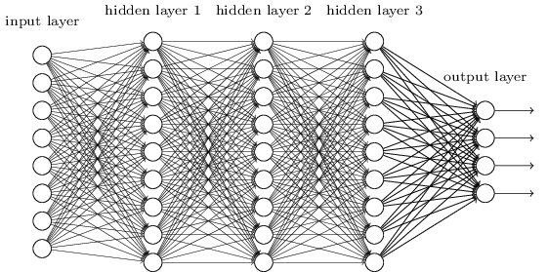
WHAT IS DEEP NEURAL NETWORK?
Deep Neural Networks are those networks that have more than 2 layer to perform the task.
https://machinelearningmastery.com/inspirational-applications-deep-learning/

Slide 6
WHY DO WE NEED DEEP NEURAL NETWORK?
Neural nets tend to be computationally expensive for data with simple patterns; in such cases you should use a model like Logistic Regression or an SVM.
As the pattern complexity increases, neural nets start to outperform other machine learning methods.
Neural nets with a small number of layers will require a number of nodes that grows exponentially with the number of unique patterns.

Slide 7
AGENDA
Introduction to CNN
Gist of Neural Network
Architecture of CNN
20

Slide 8
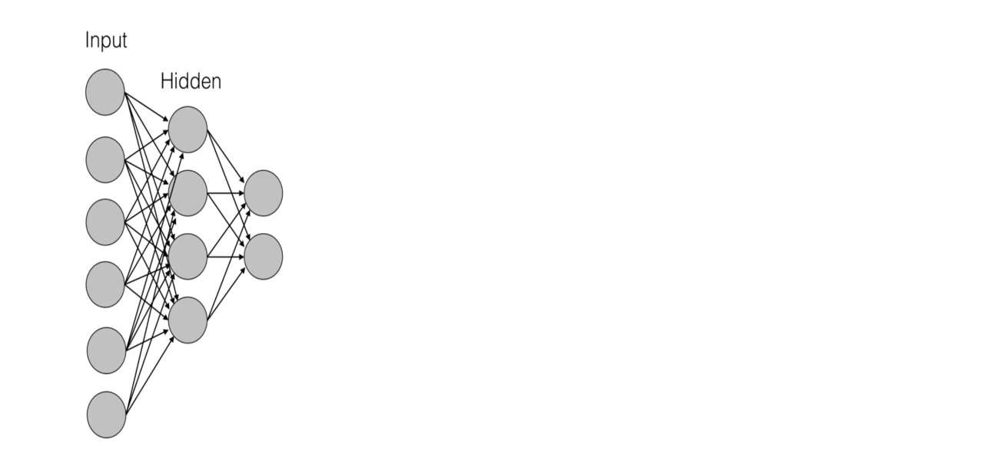
WHY CONVOLUTIONAL NEURAL NETWORK?
.

Slide 9
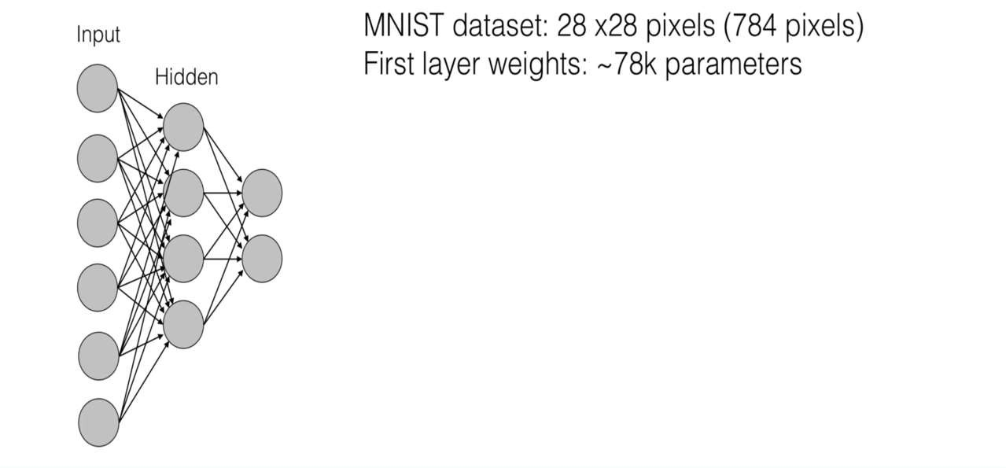
WHY CONVOLUTIONAL NEURAL NETWORK?
.

Slide 10
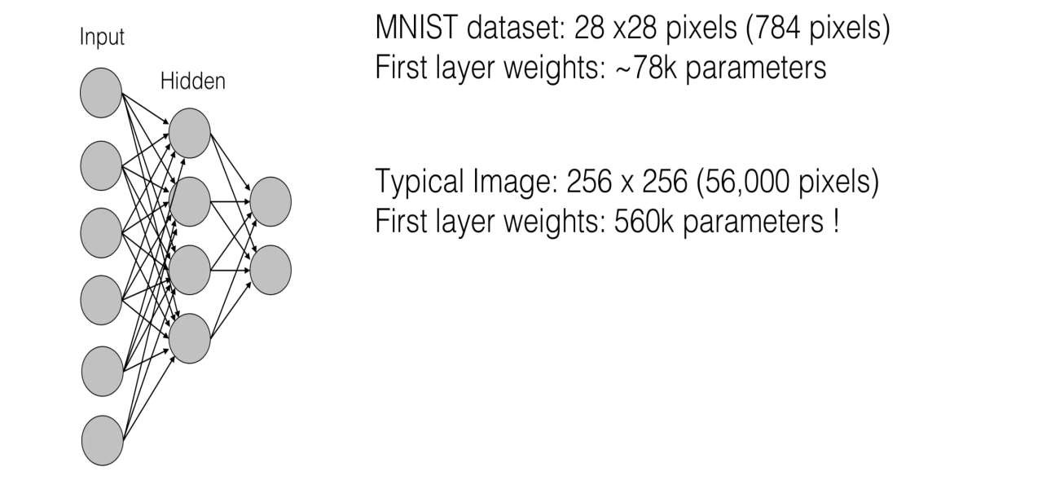
WHY CONVOLUTIONAL NEURAL NETWORK?
.

Slide 11
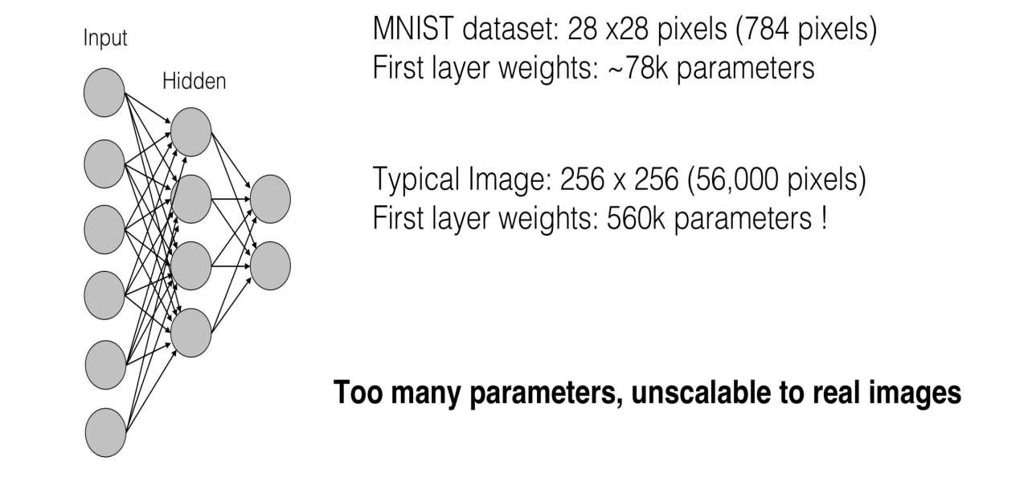
WHY CONVOLUTIONAL NEURAL NETWORK?
.

Slide 12
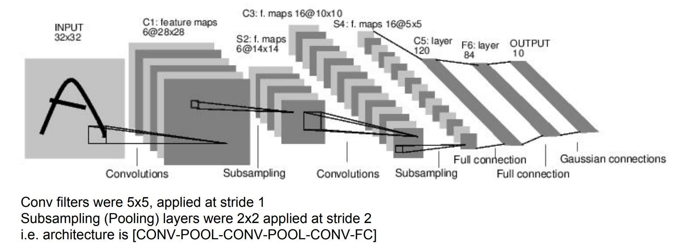
INTRODUCTION TO CNN
.

Slide 13
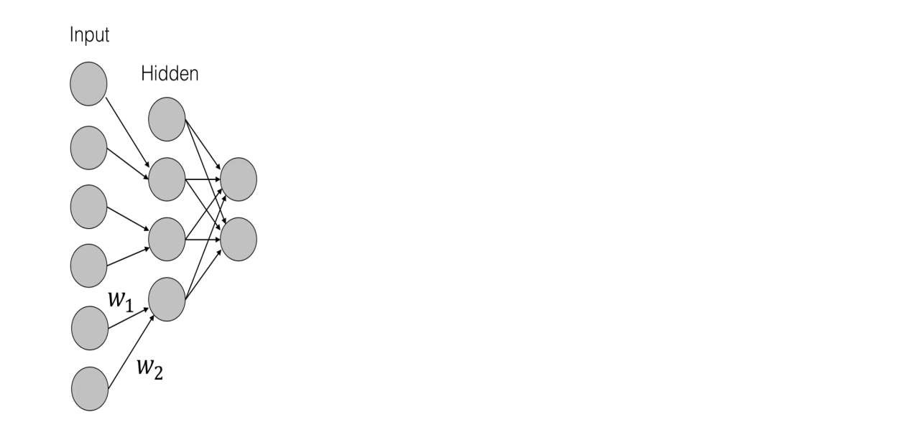
WORKING OF CNN
.

Slide 14
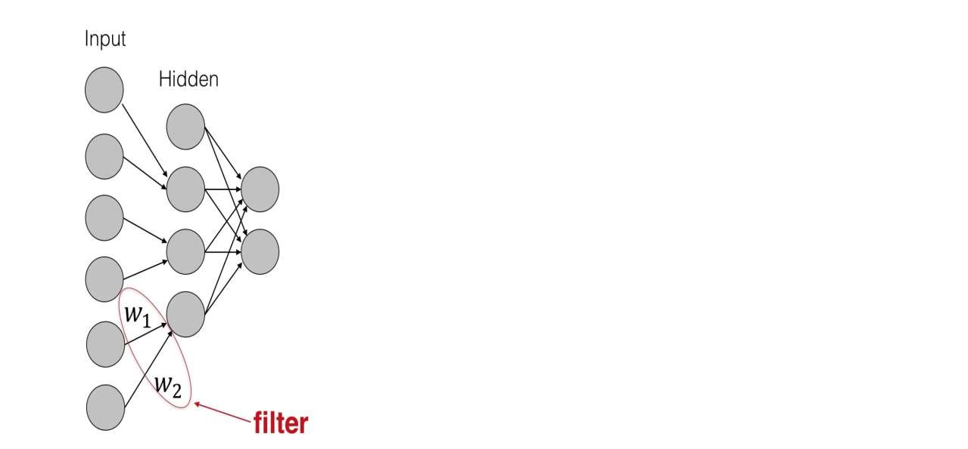
WORKING OF CNN
.

Slide 15
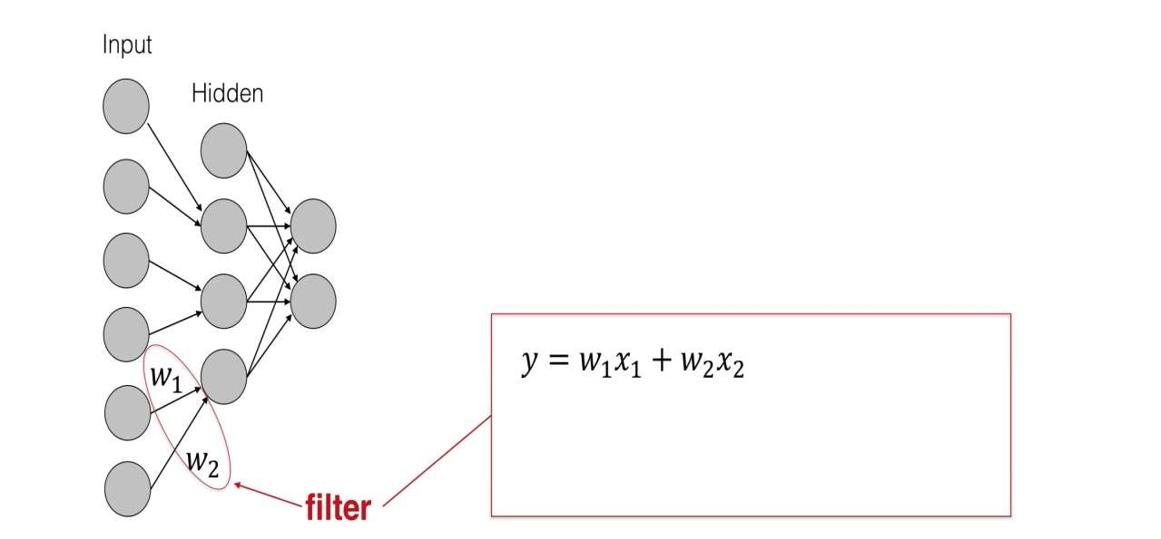
WORKING OF CNN
.

Slide 16
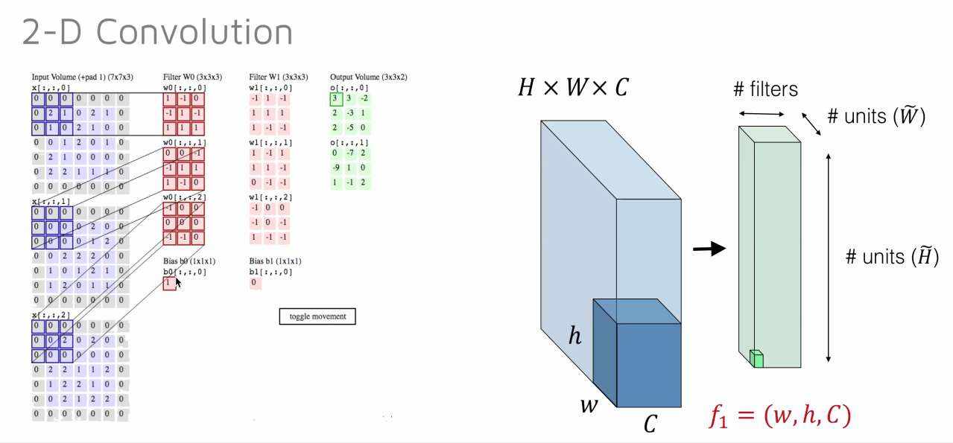
WORKING OF CNN
.

Slide 17
CNN layers
CNN layers
Convolution Layer
Non-Linear Activation Layer (ReLu)
Pooling Layer

Slide 18
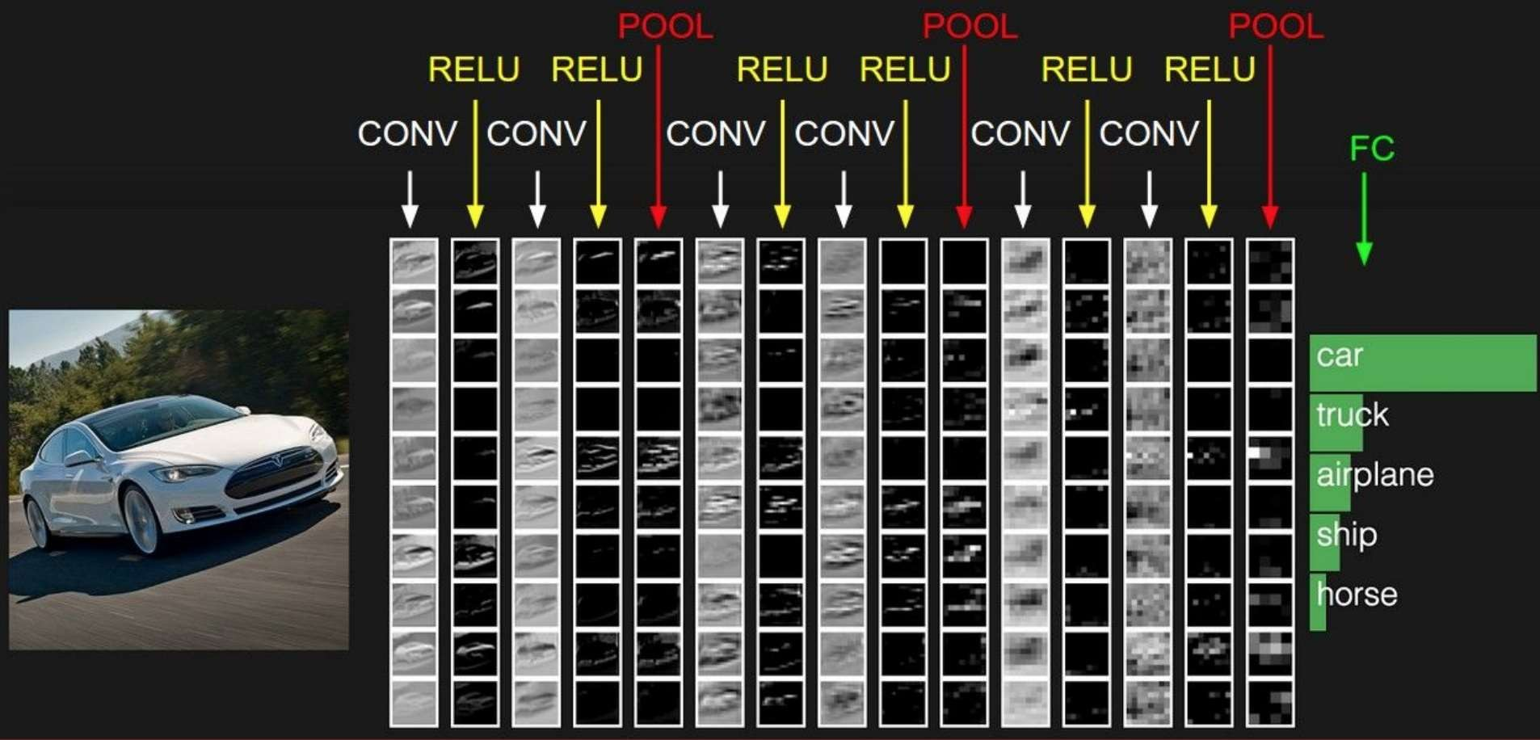
LAYERS IN CNN
.

Slide 19
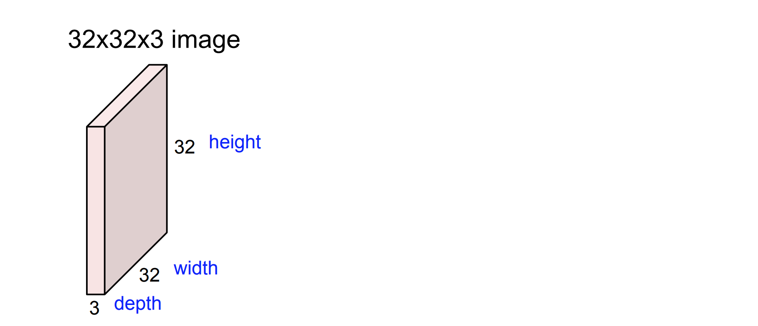
CONVOLUTION LAYER
.

Slide 20
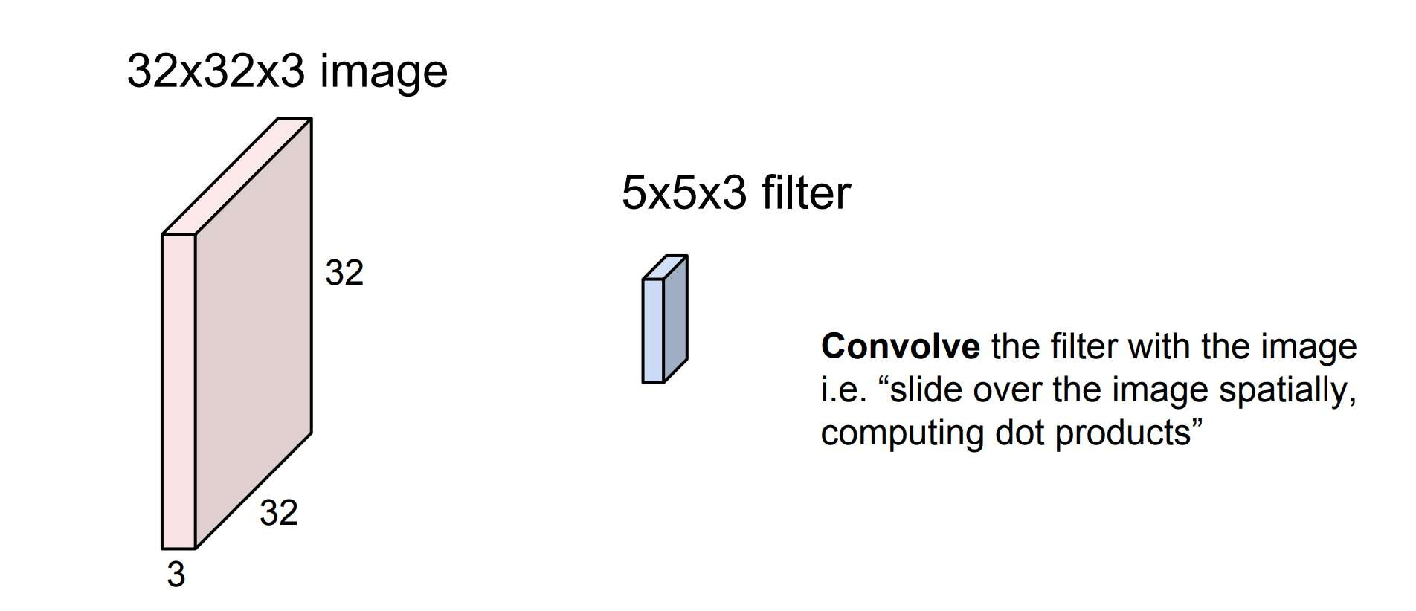
CONVOLUTION LAYER
.

Slide 21
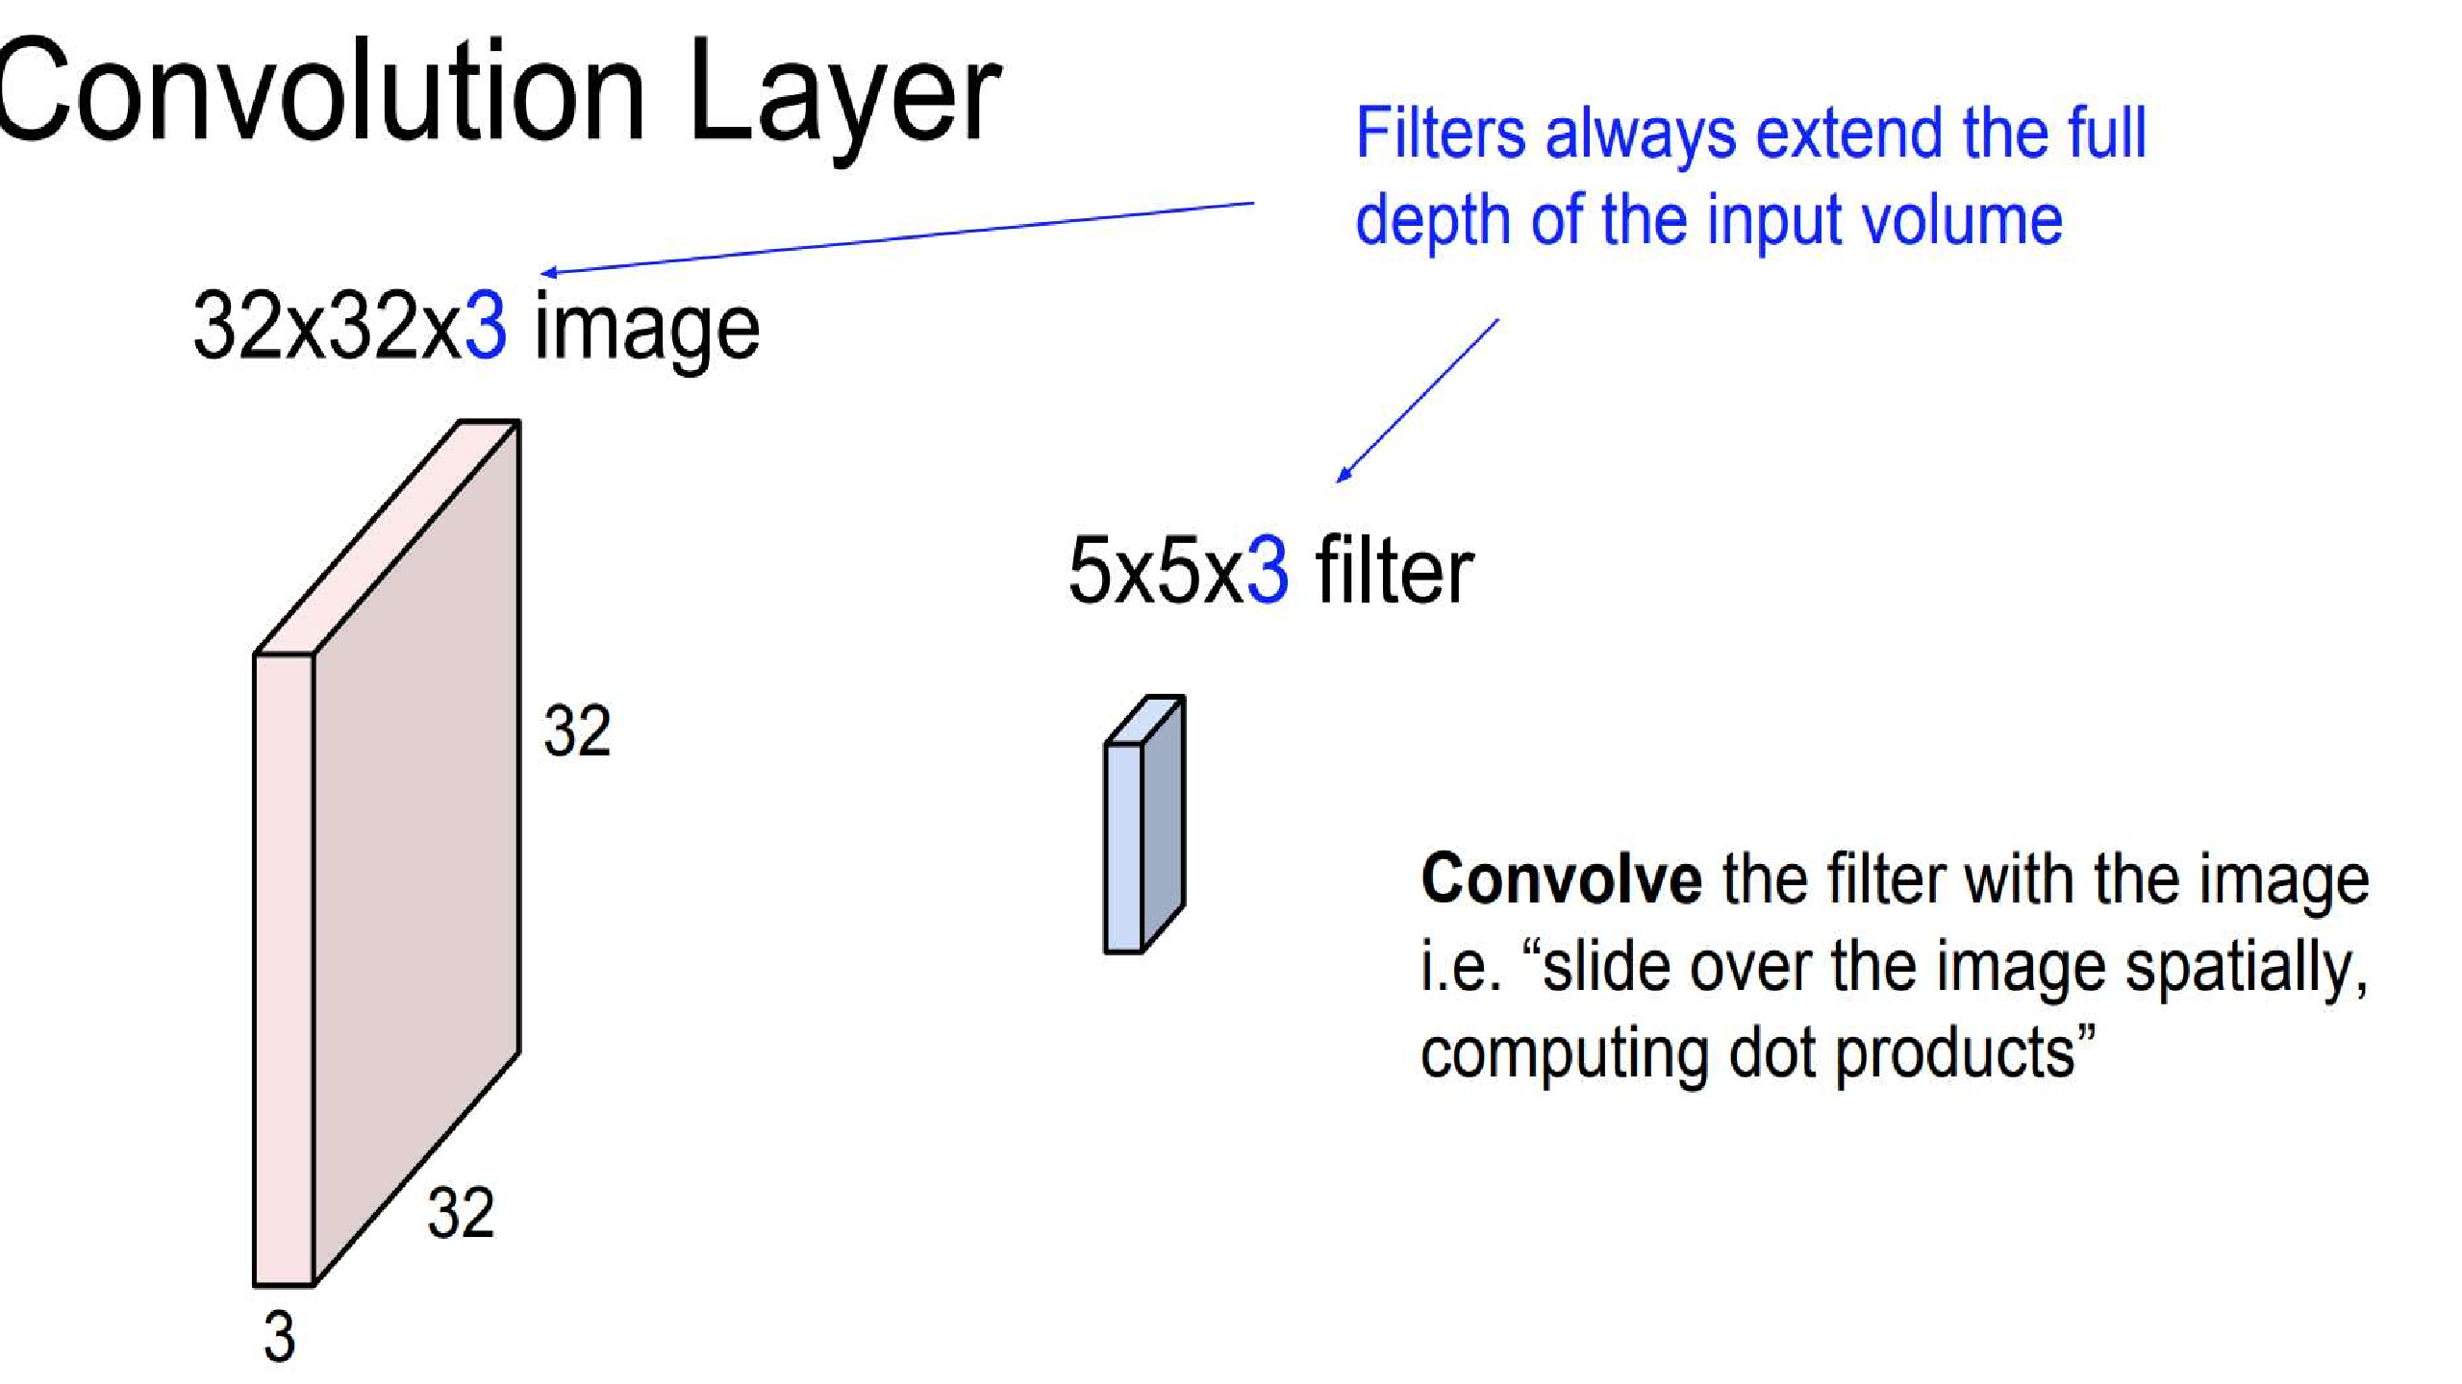
.

Slide 22
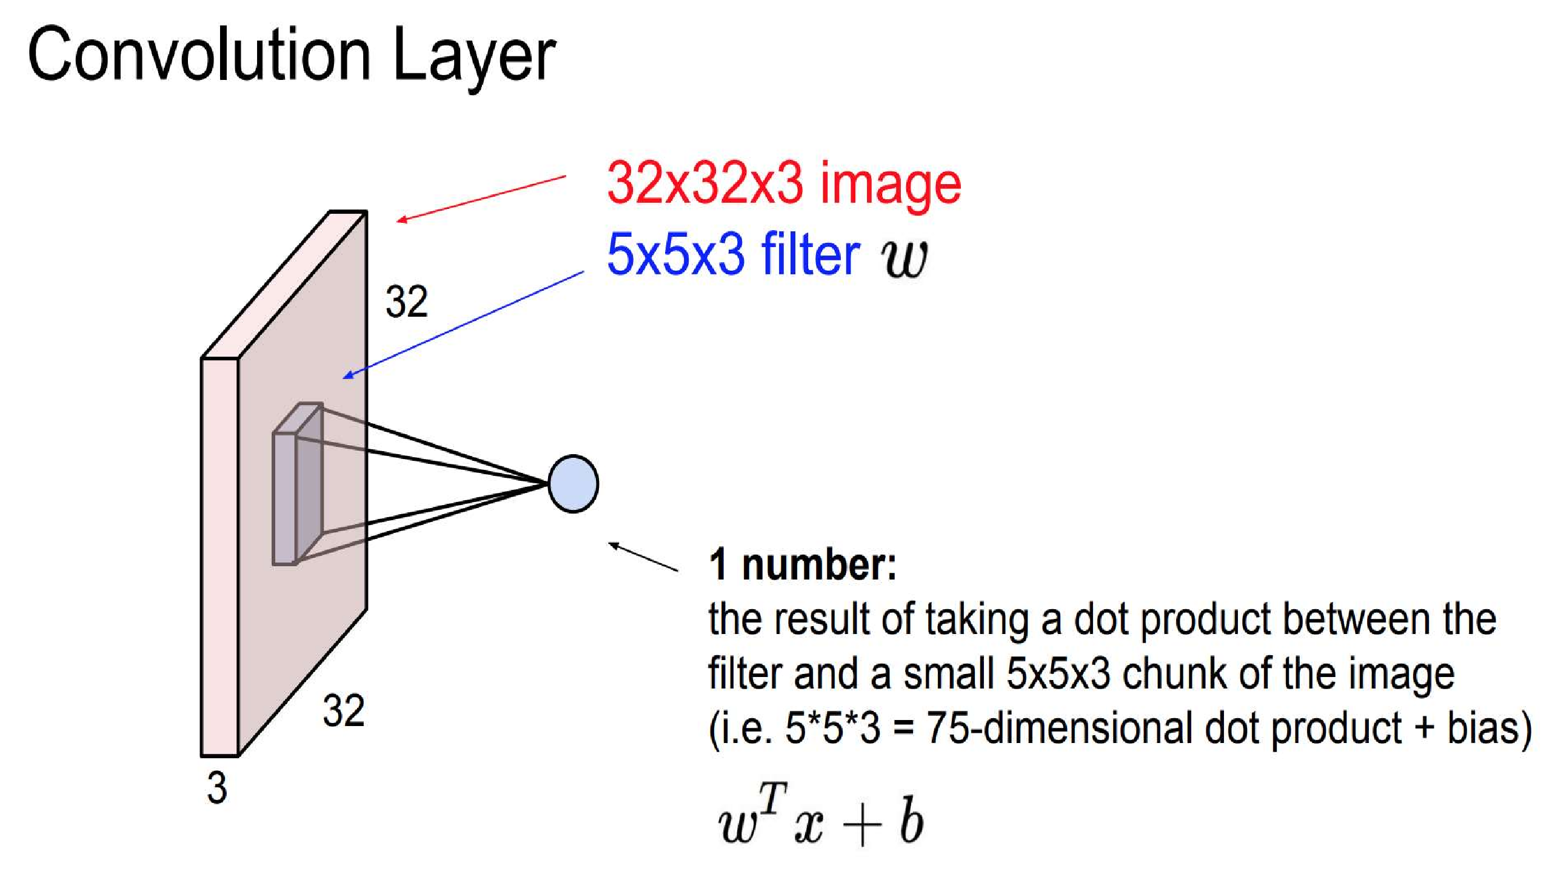
.

Slide 23
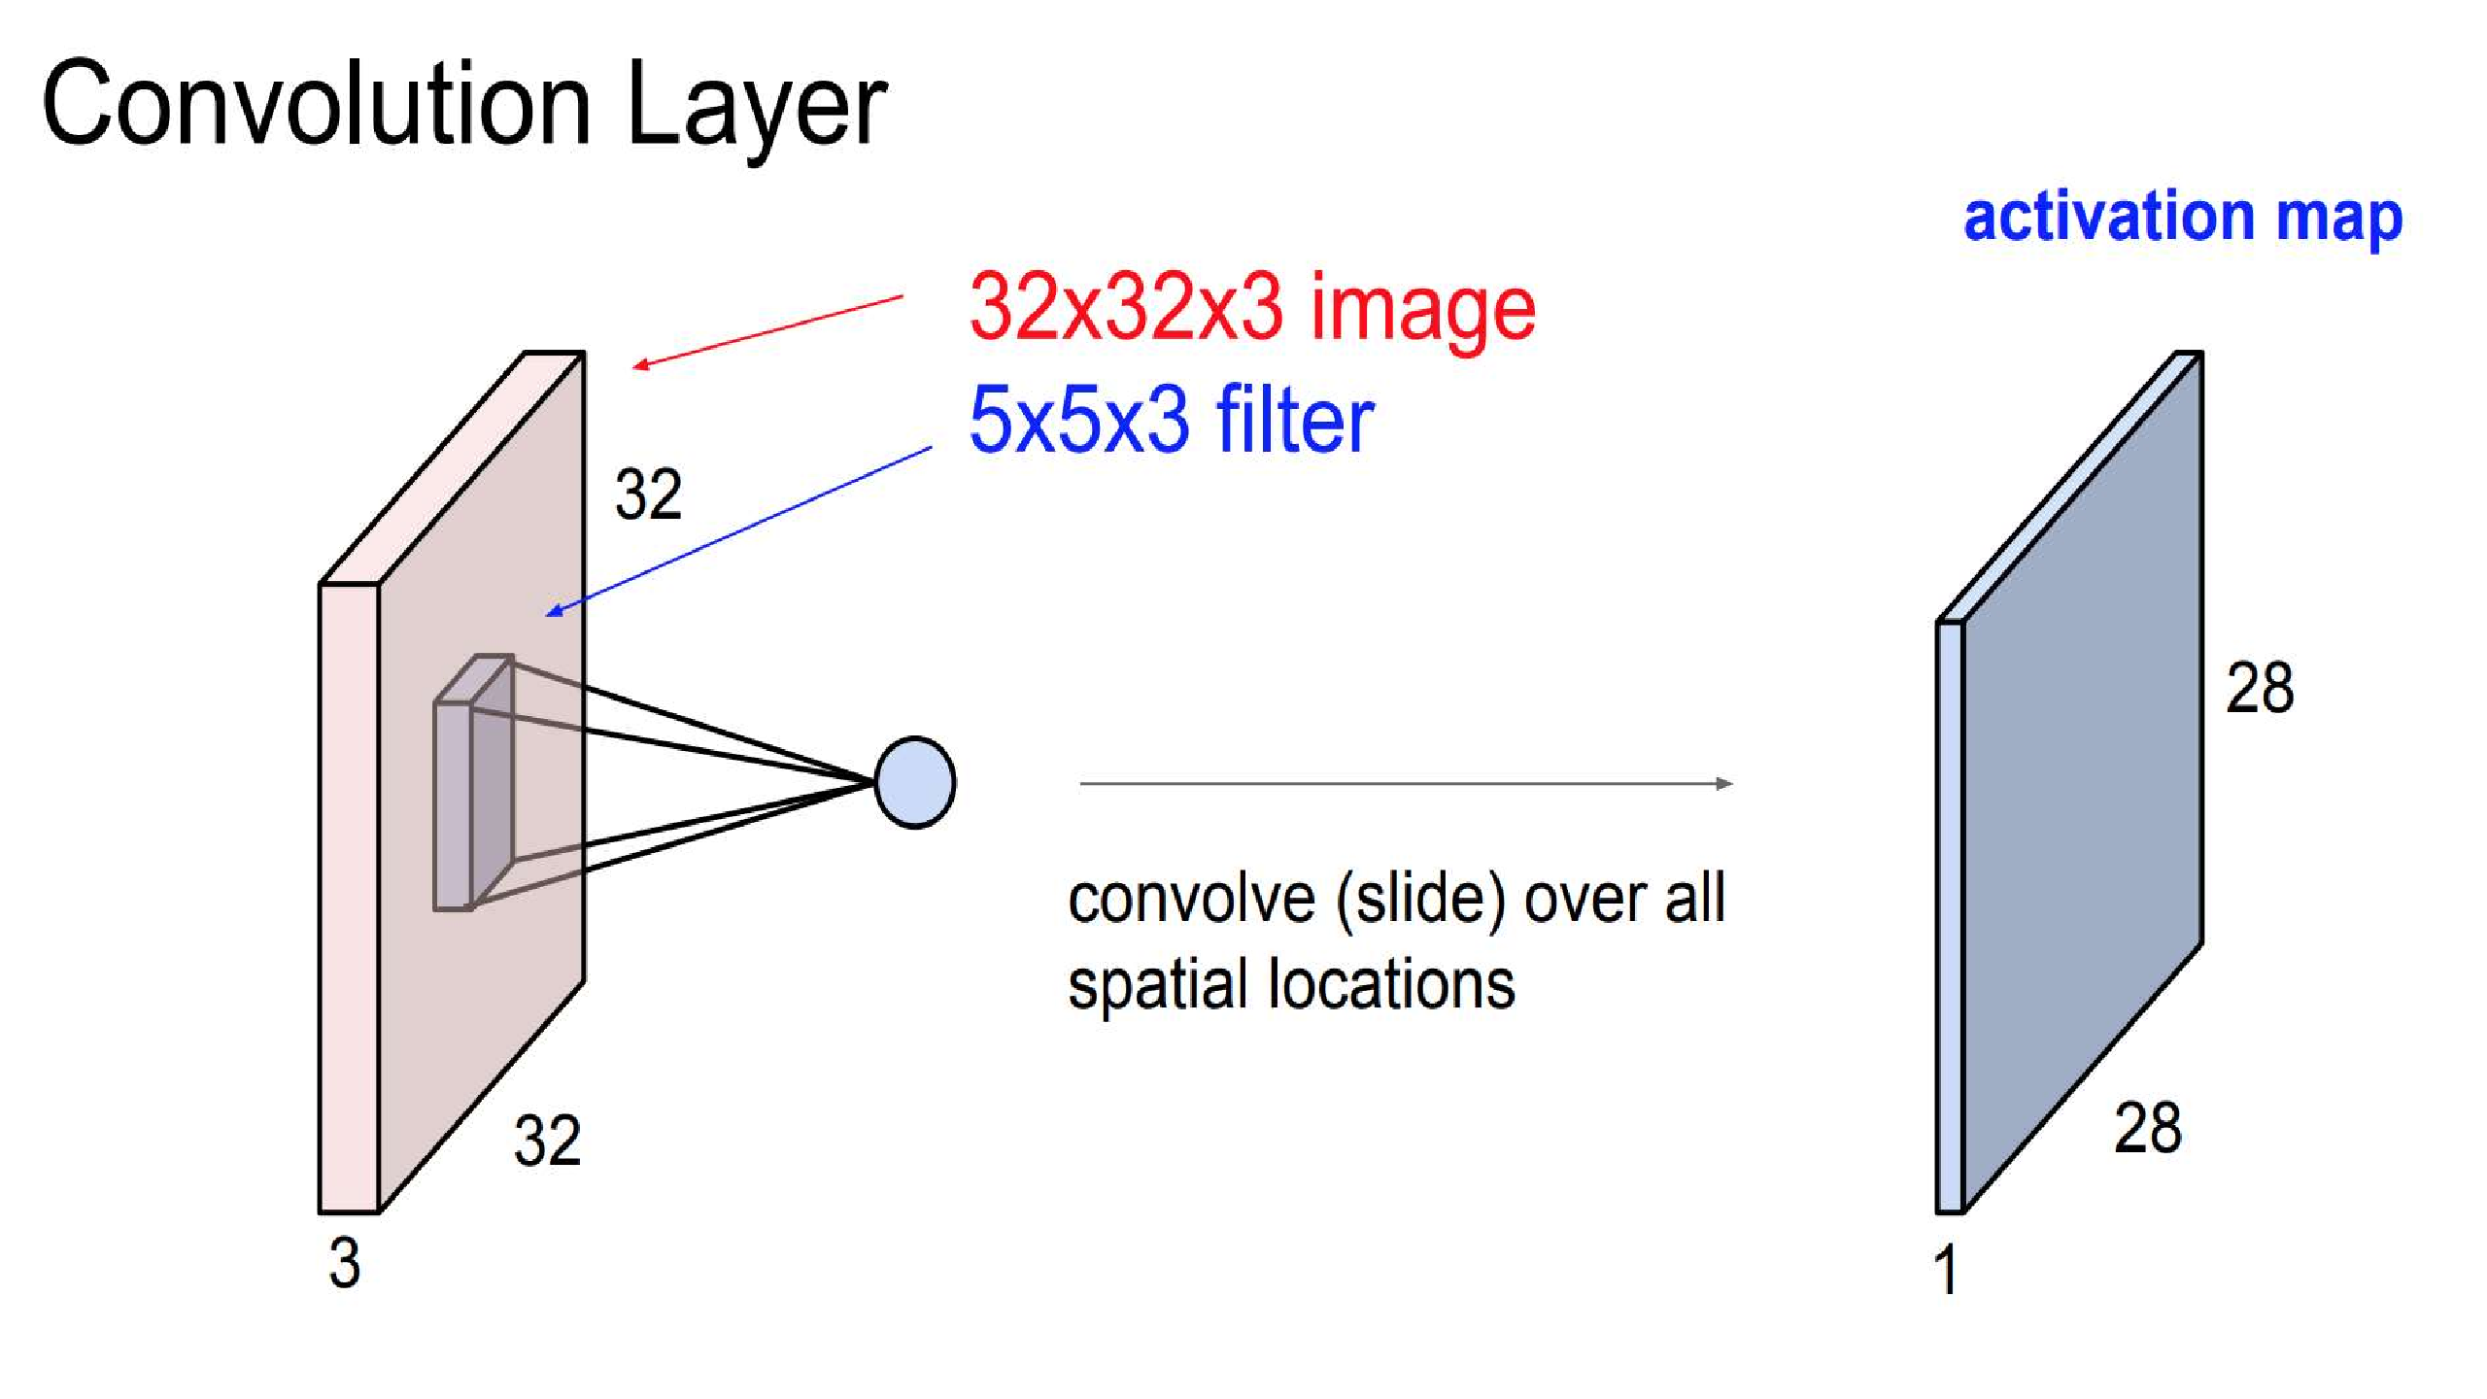
.

Slide 24
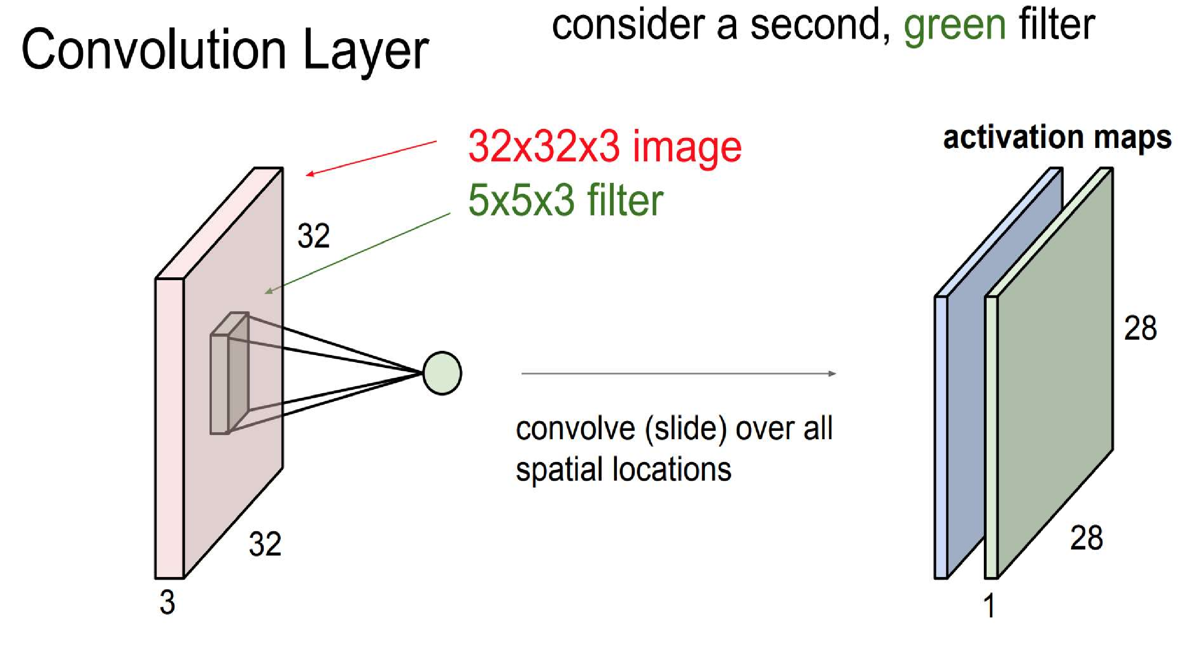
.

Slide 25
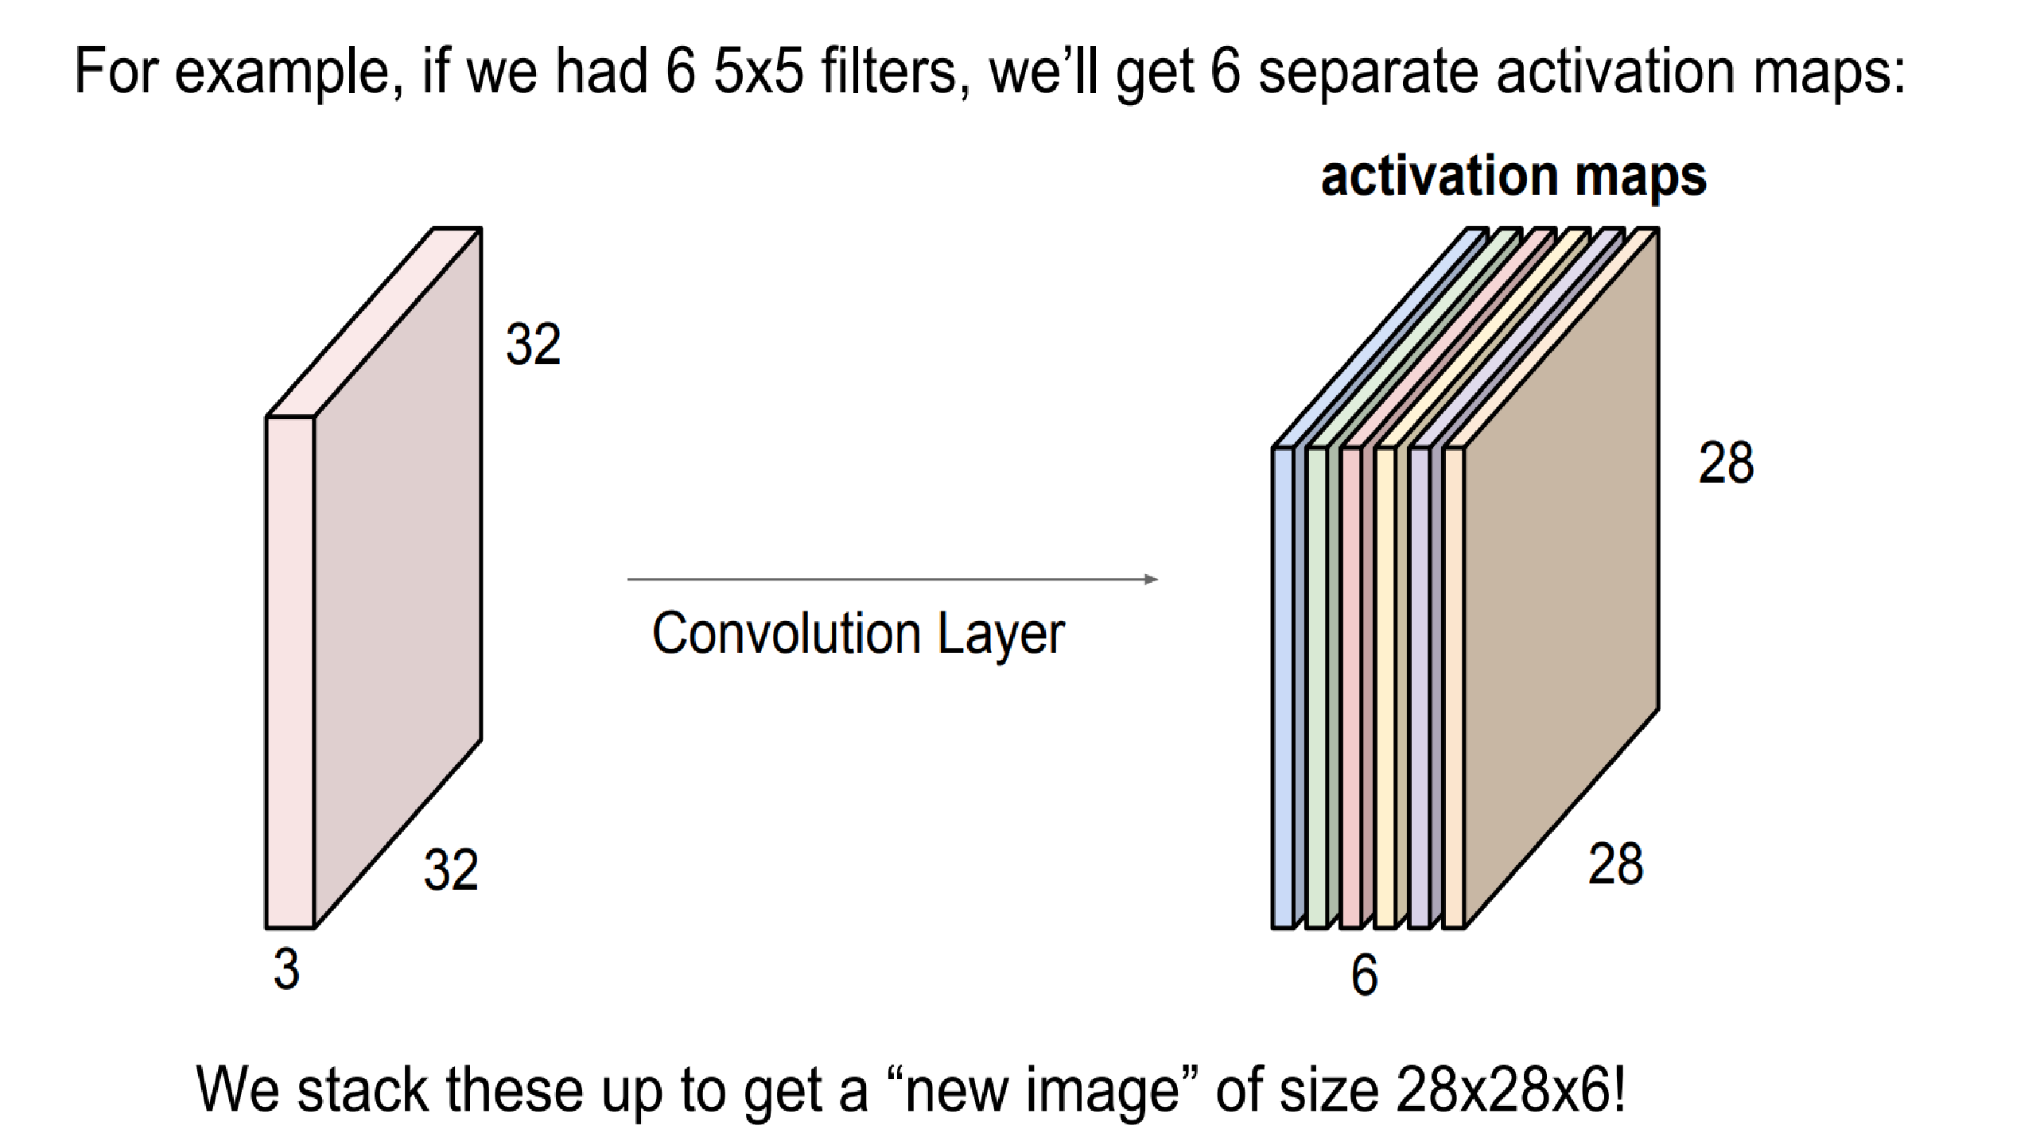
.

Slide 26
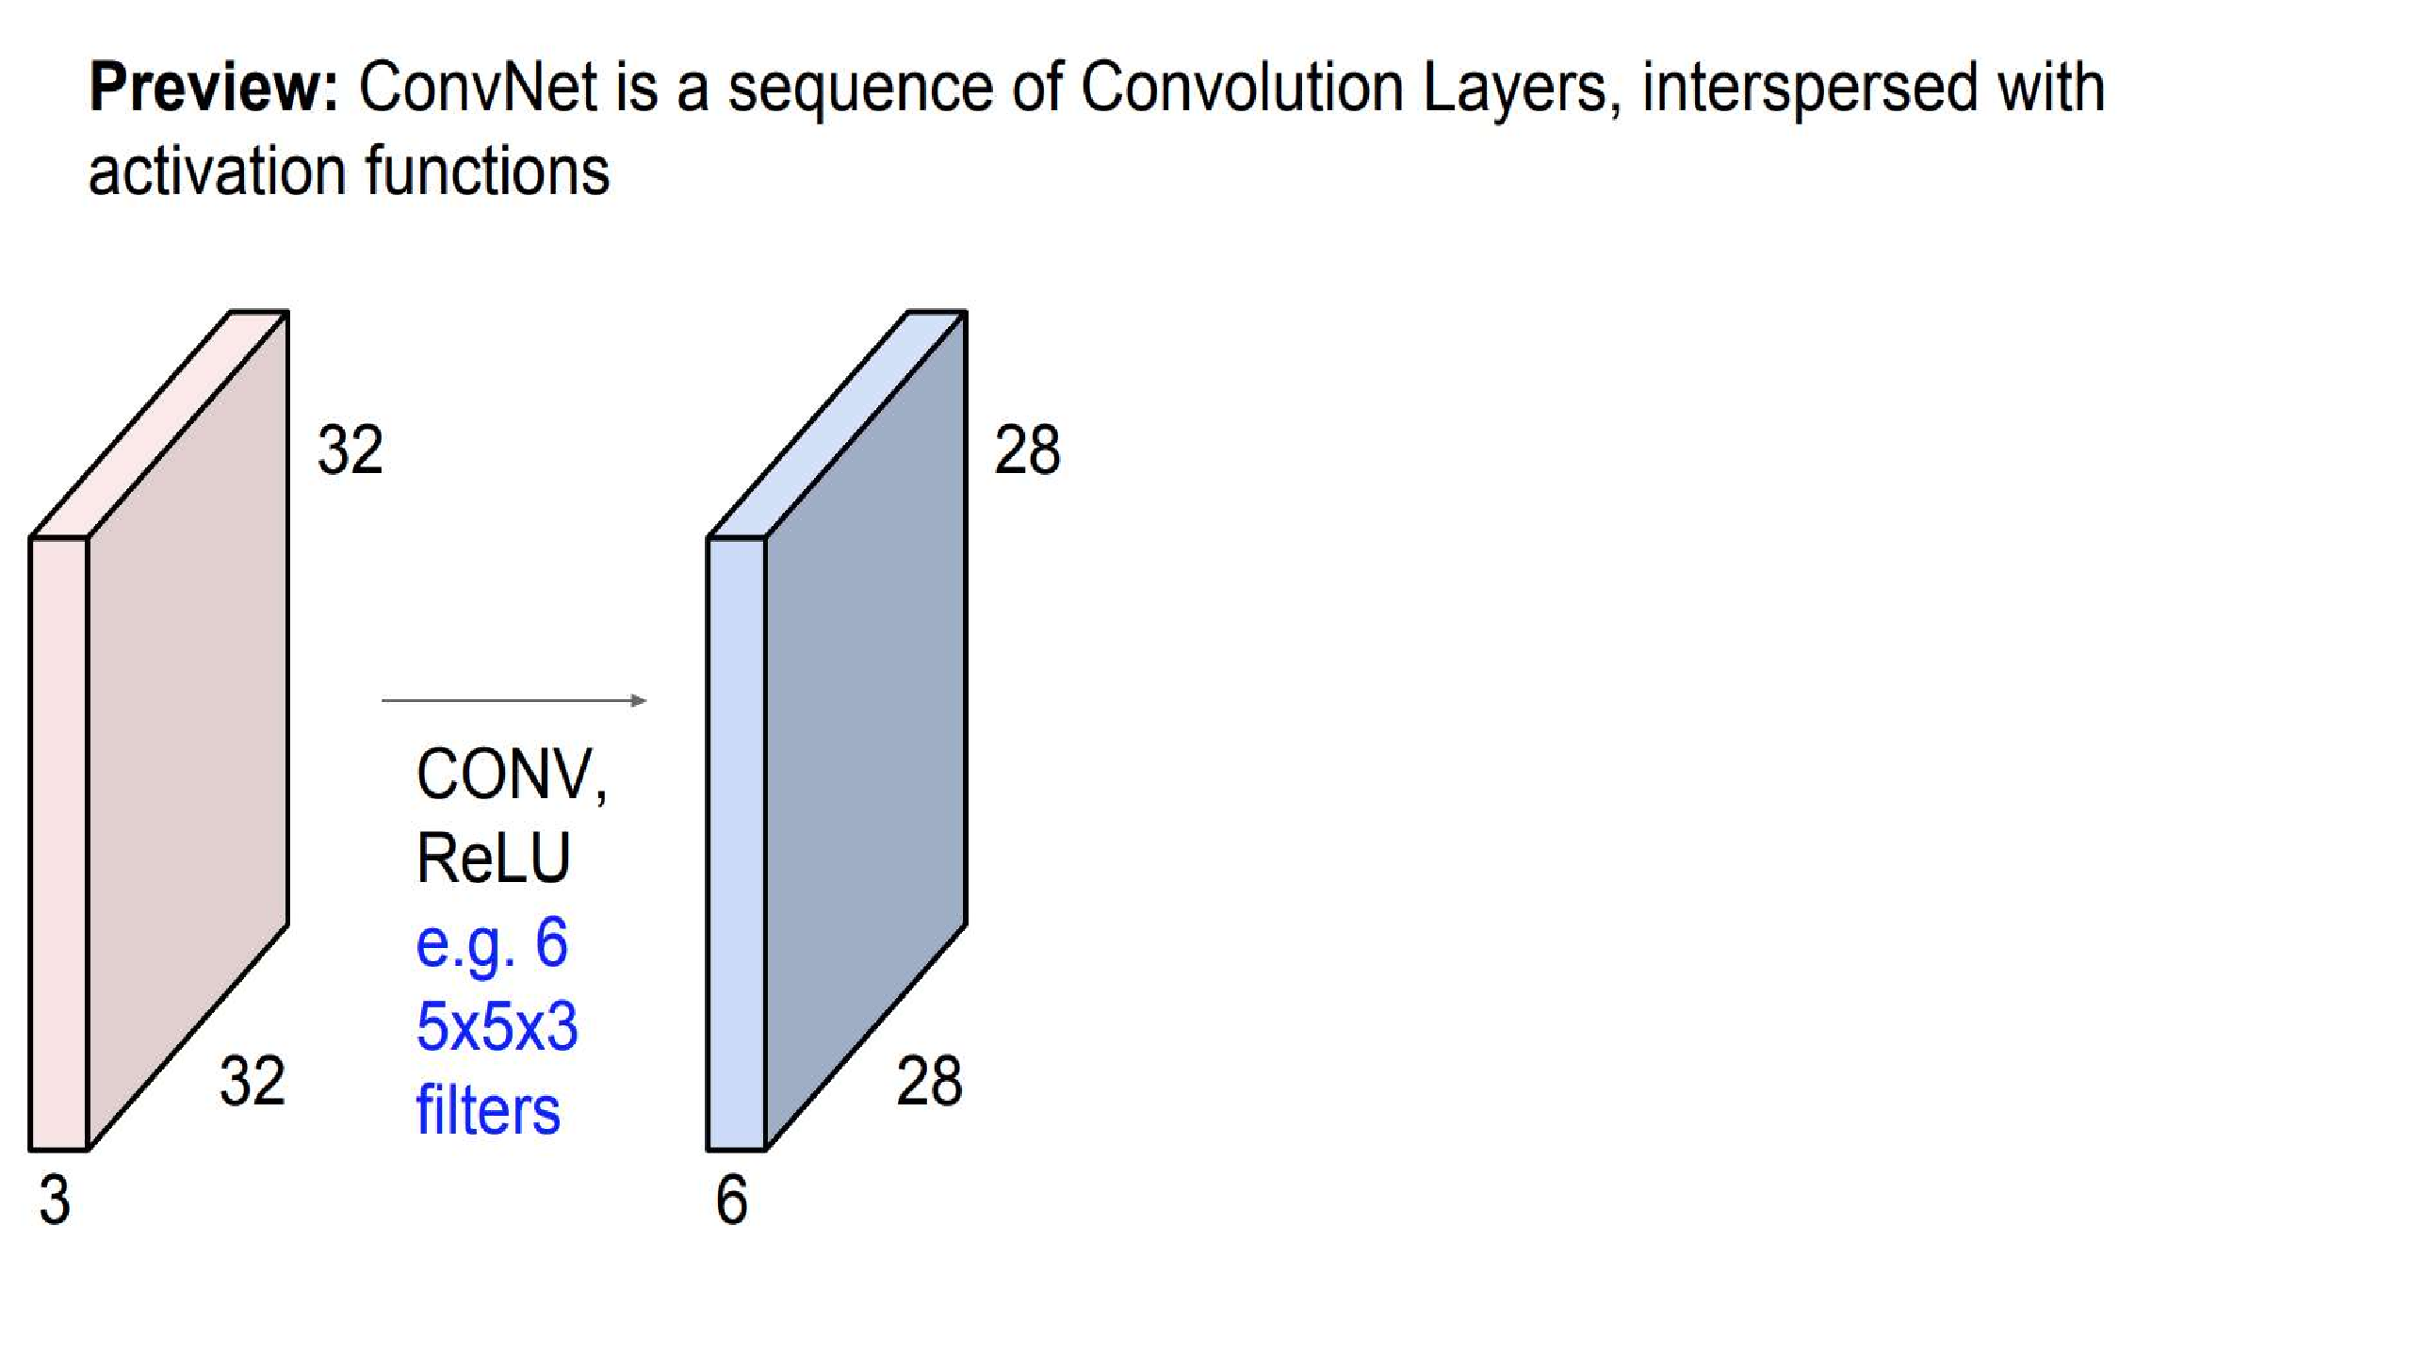
.

Slide 27
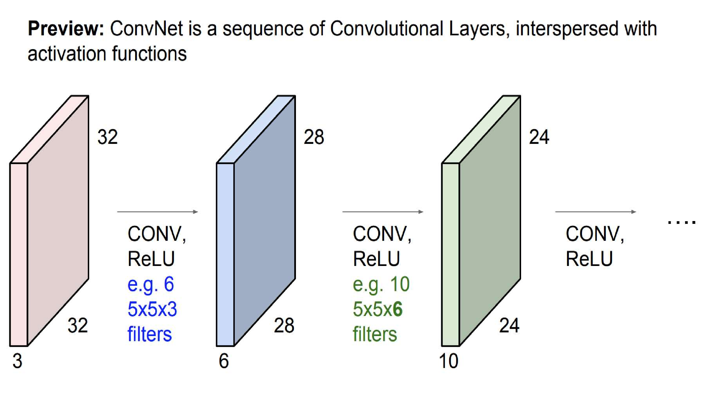
.

Slide 28
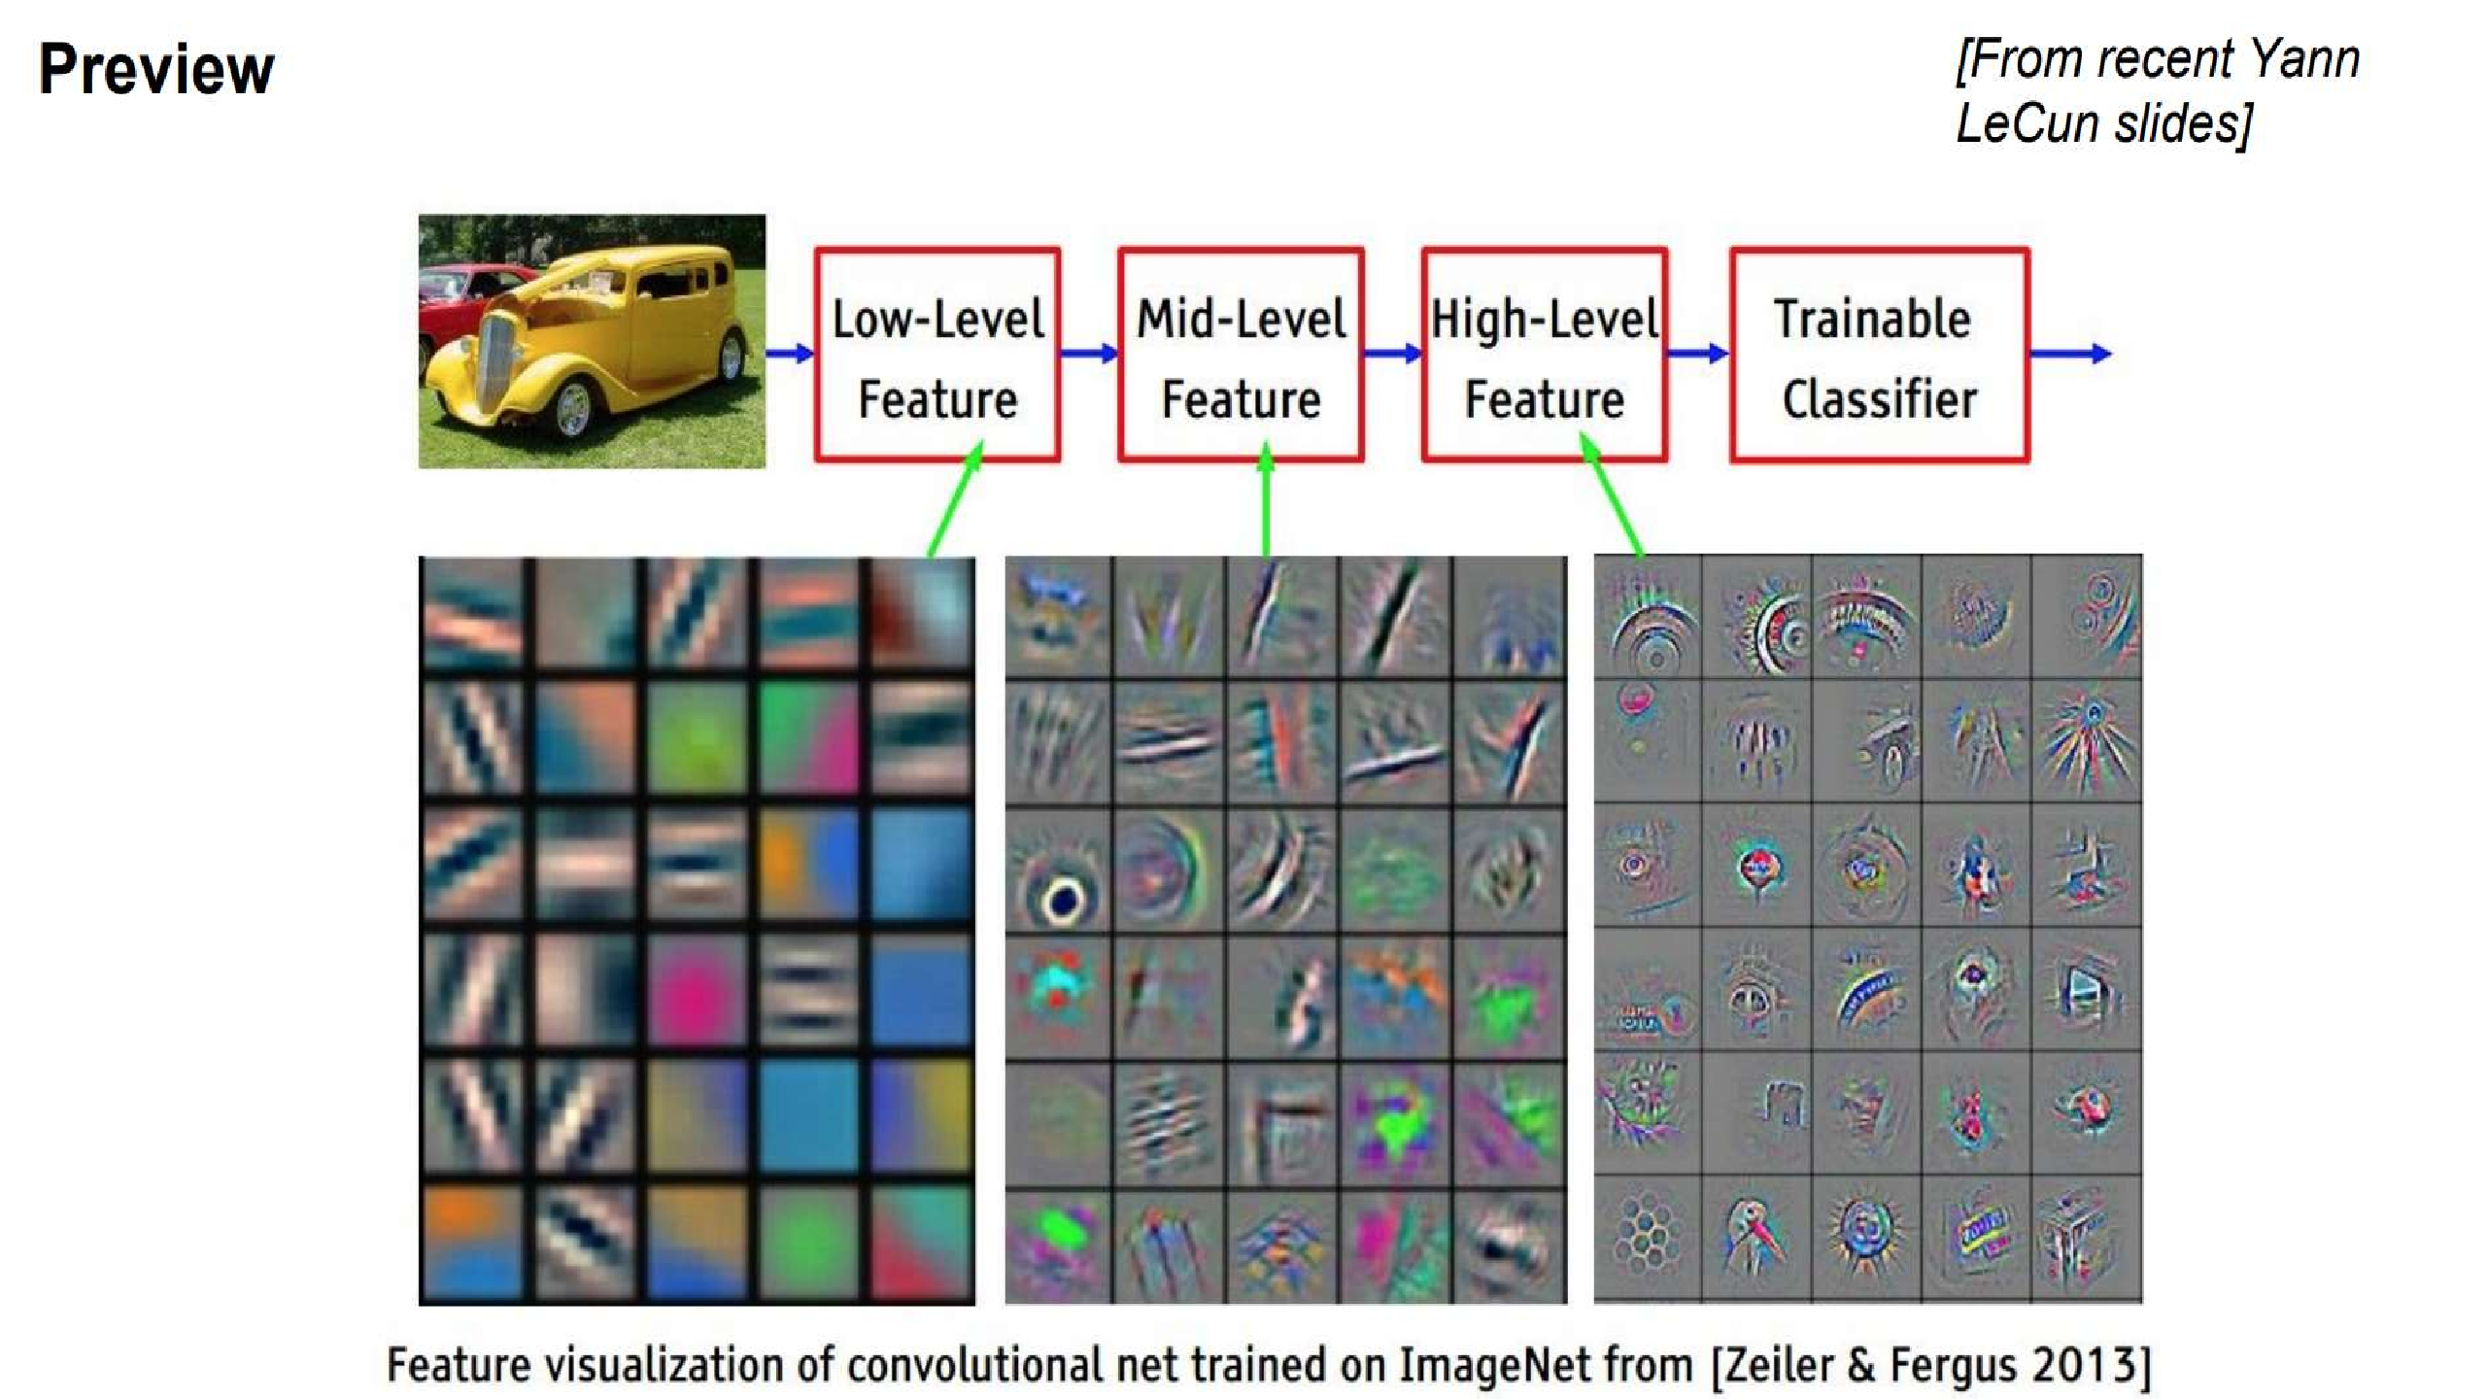
.

Slide 29
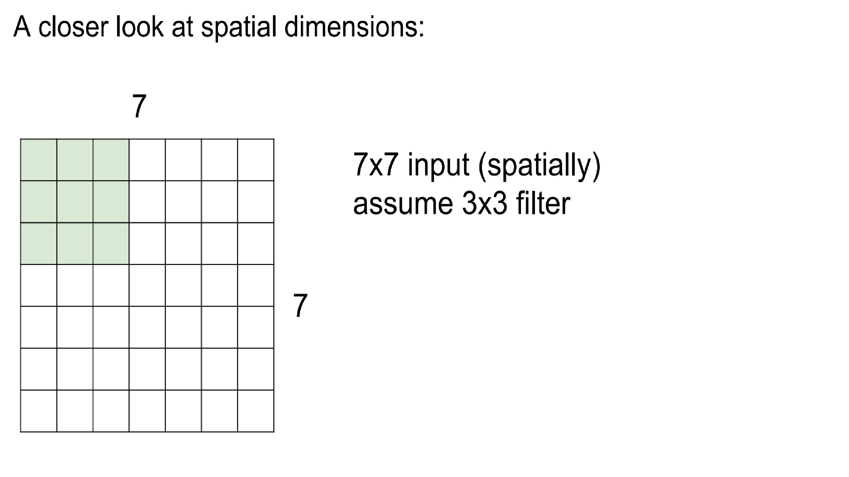
.

Slide 30
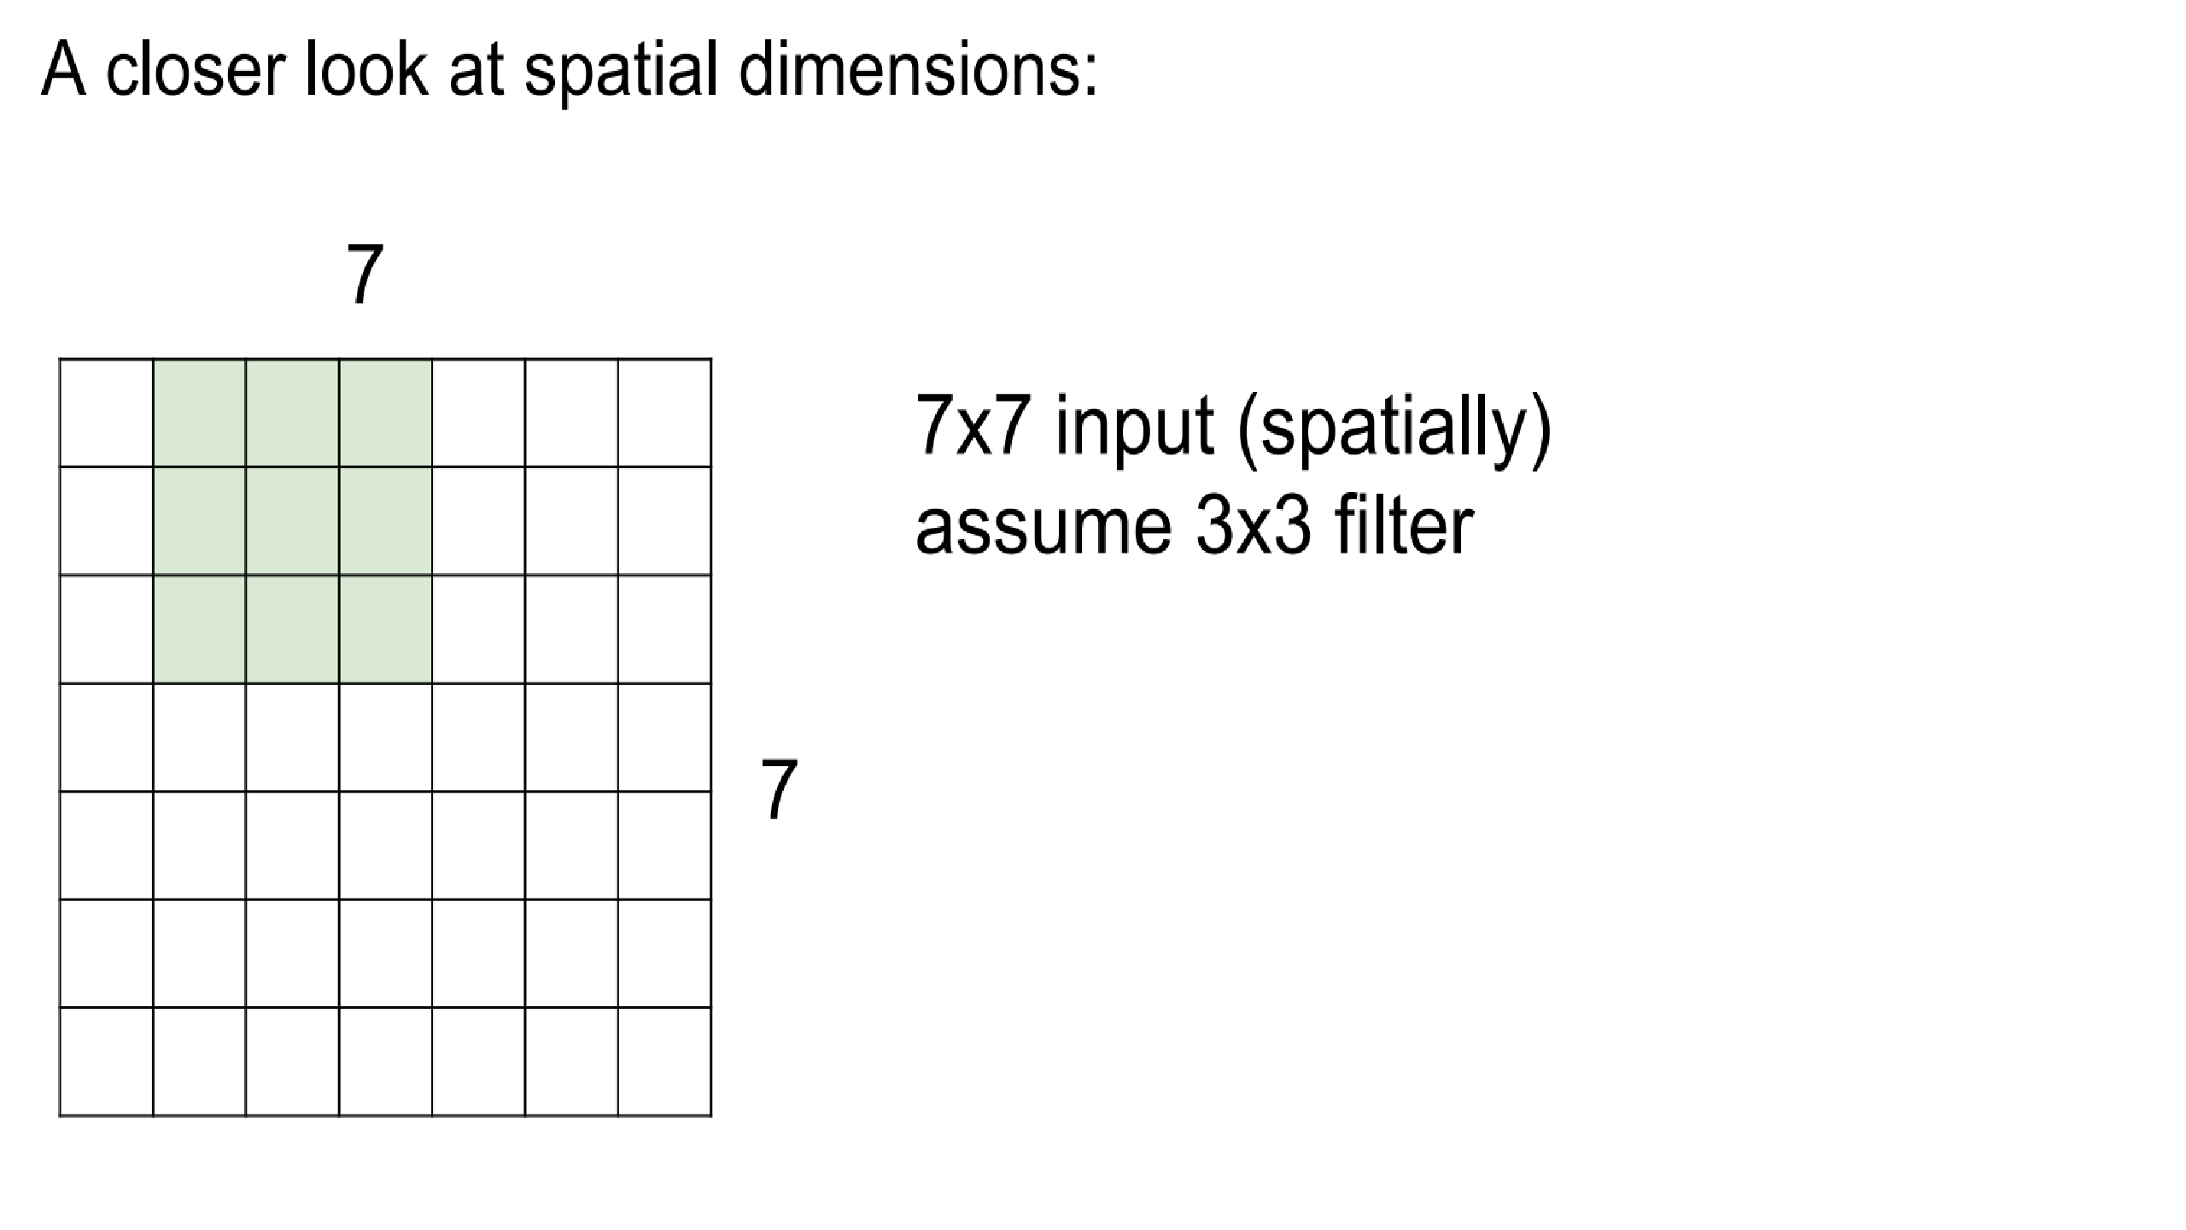
.

Slide 31
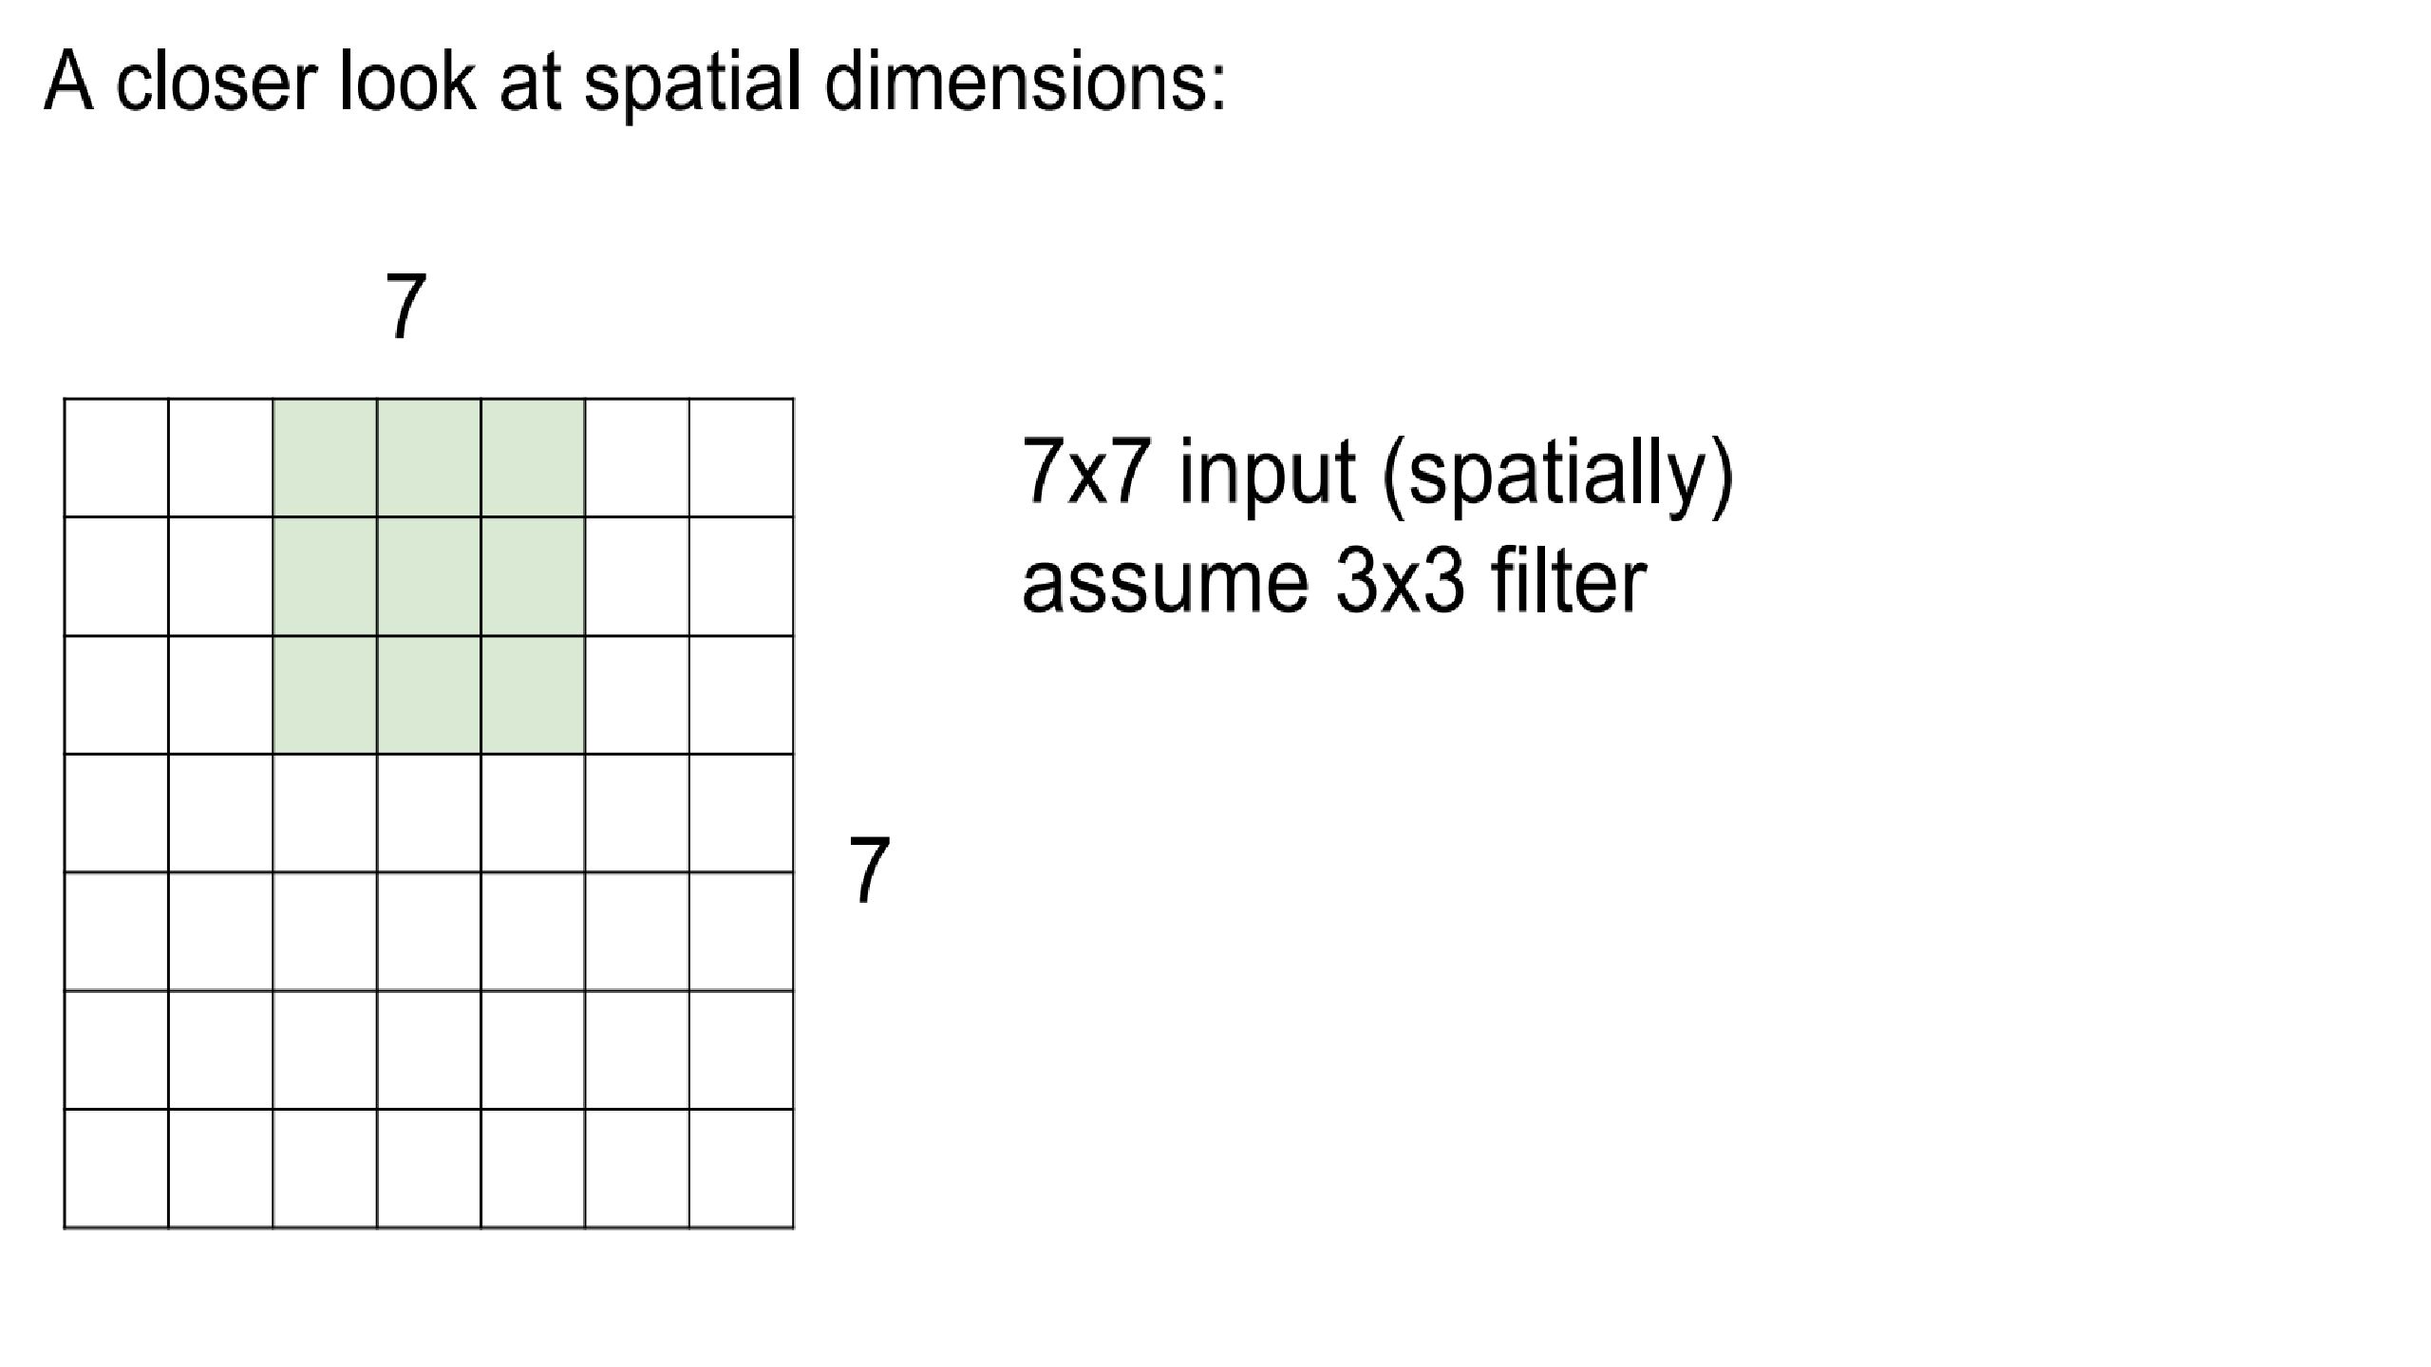
.

Slide 32
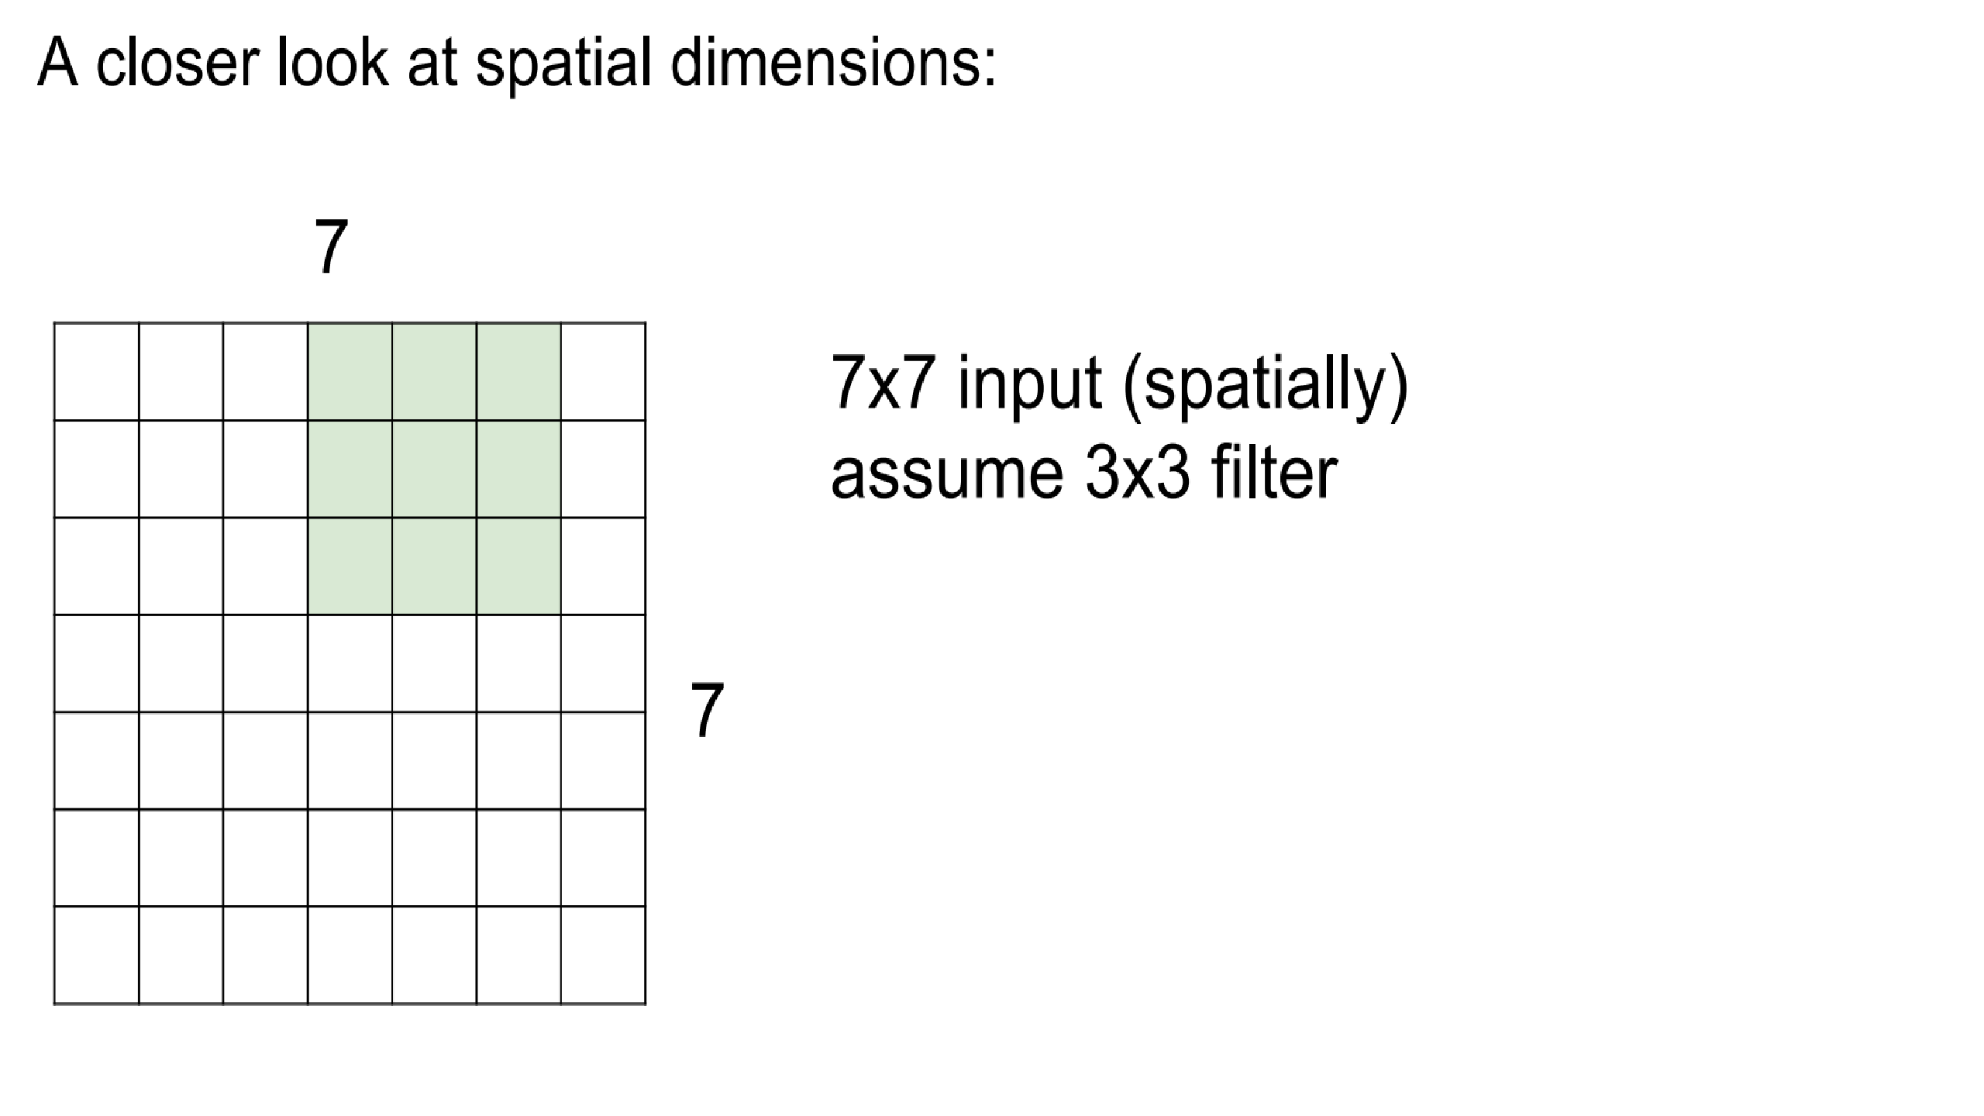
.

Slide 33
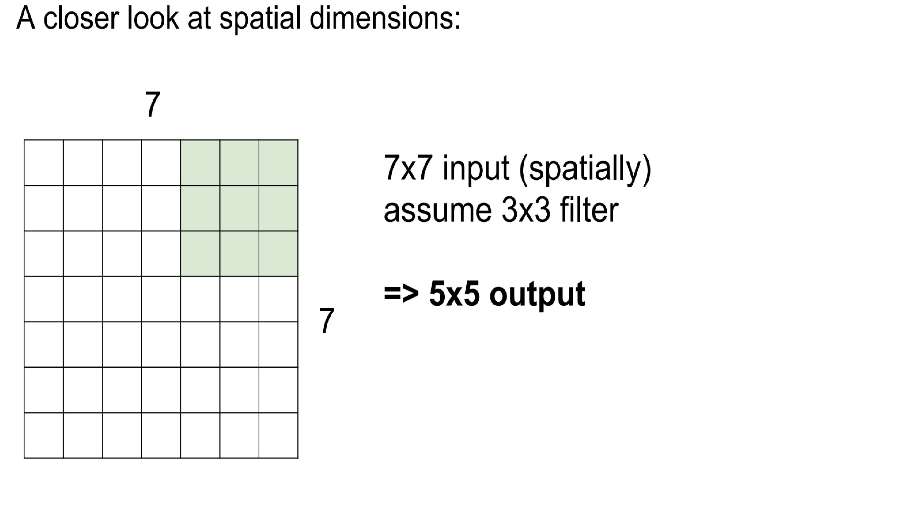
.

Slide 34
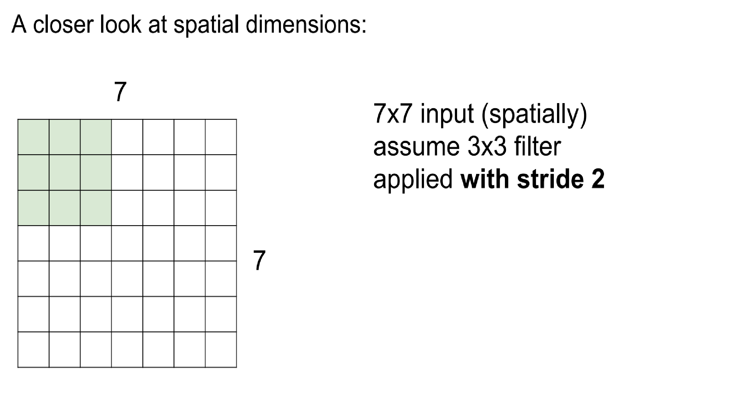
.

Slide 35
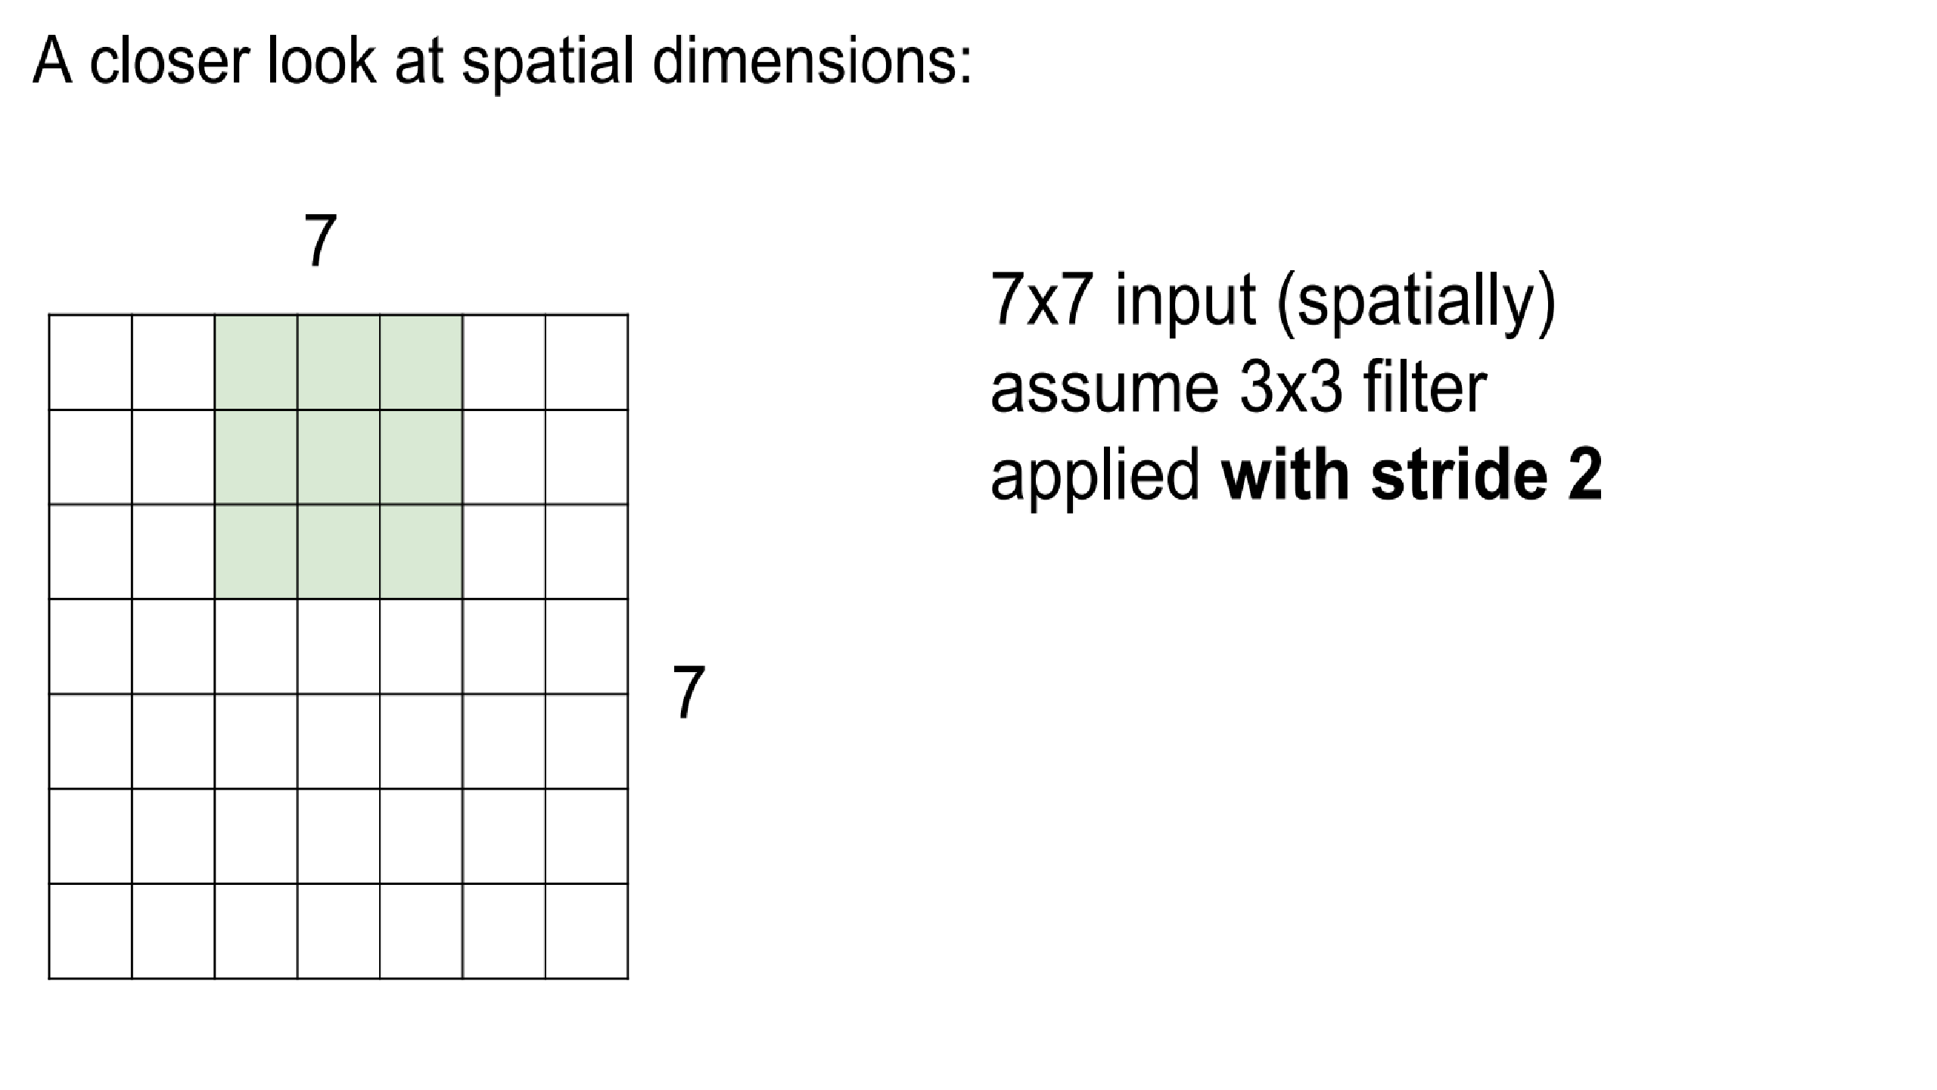
.

Slide 36
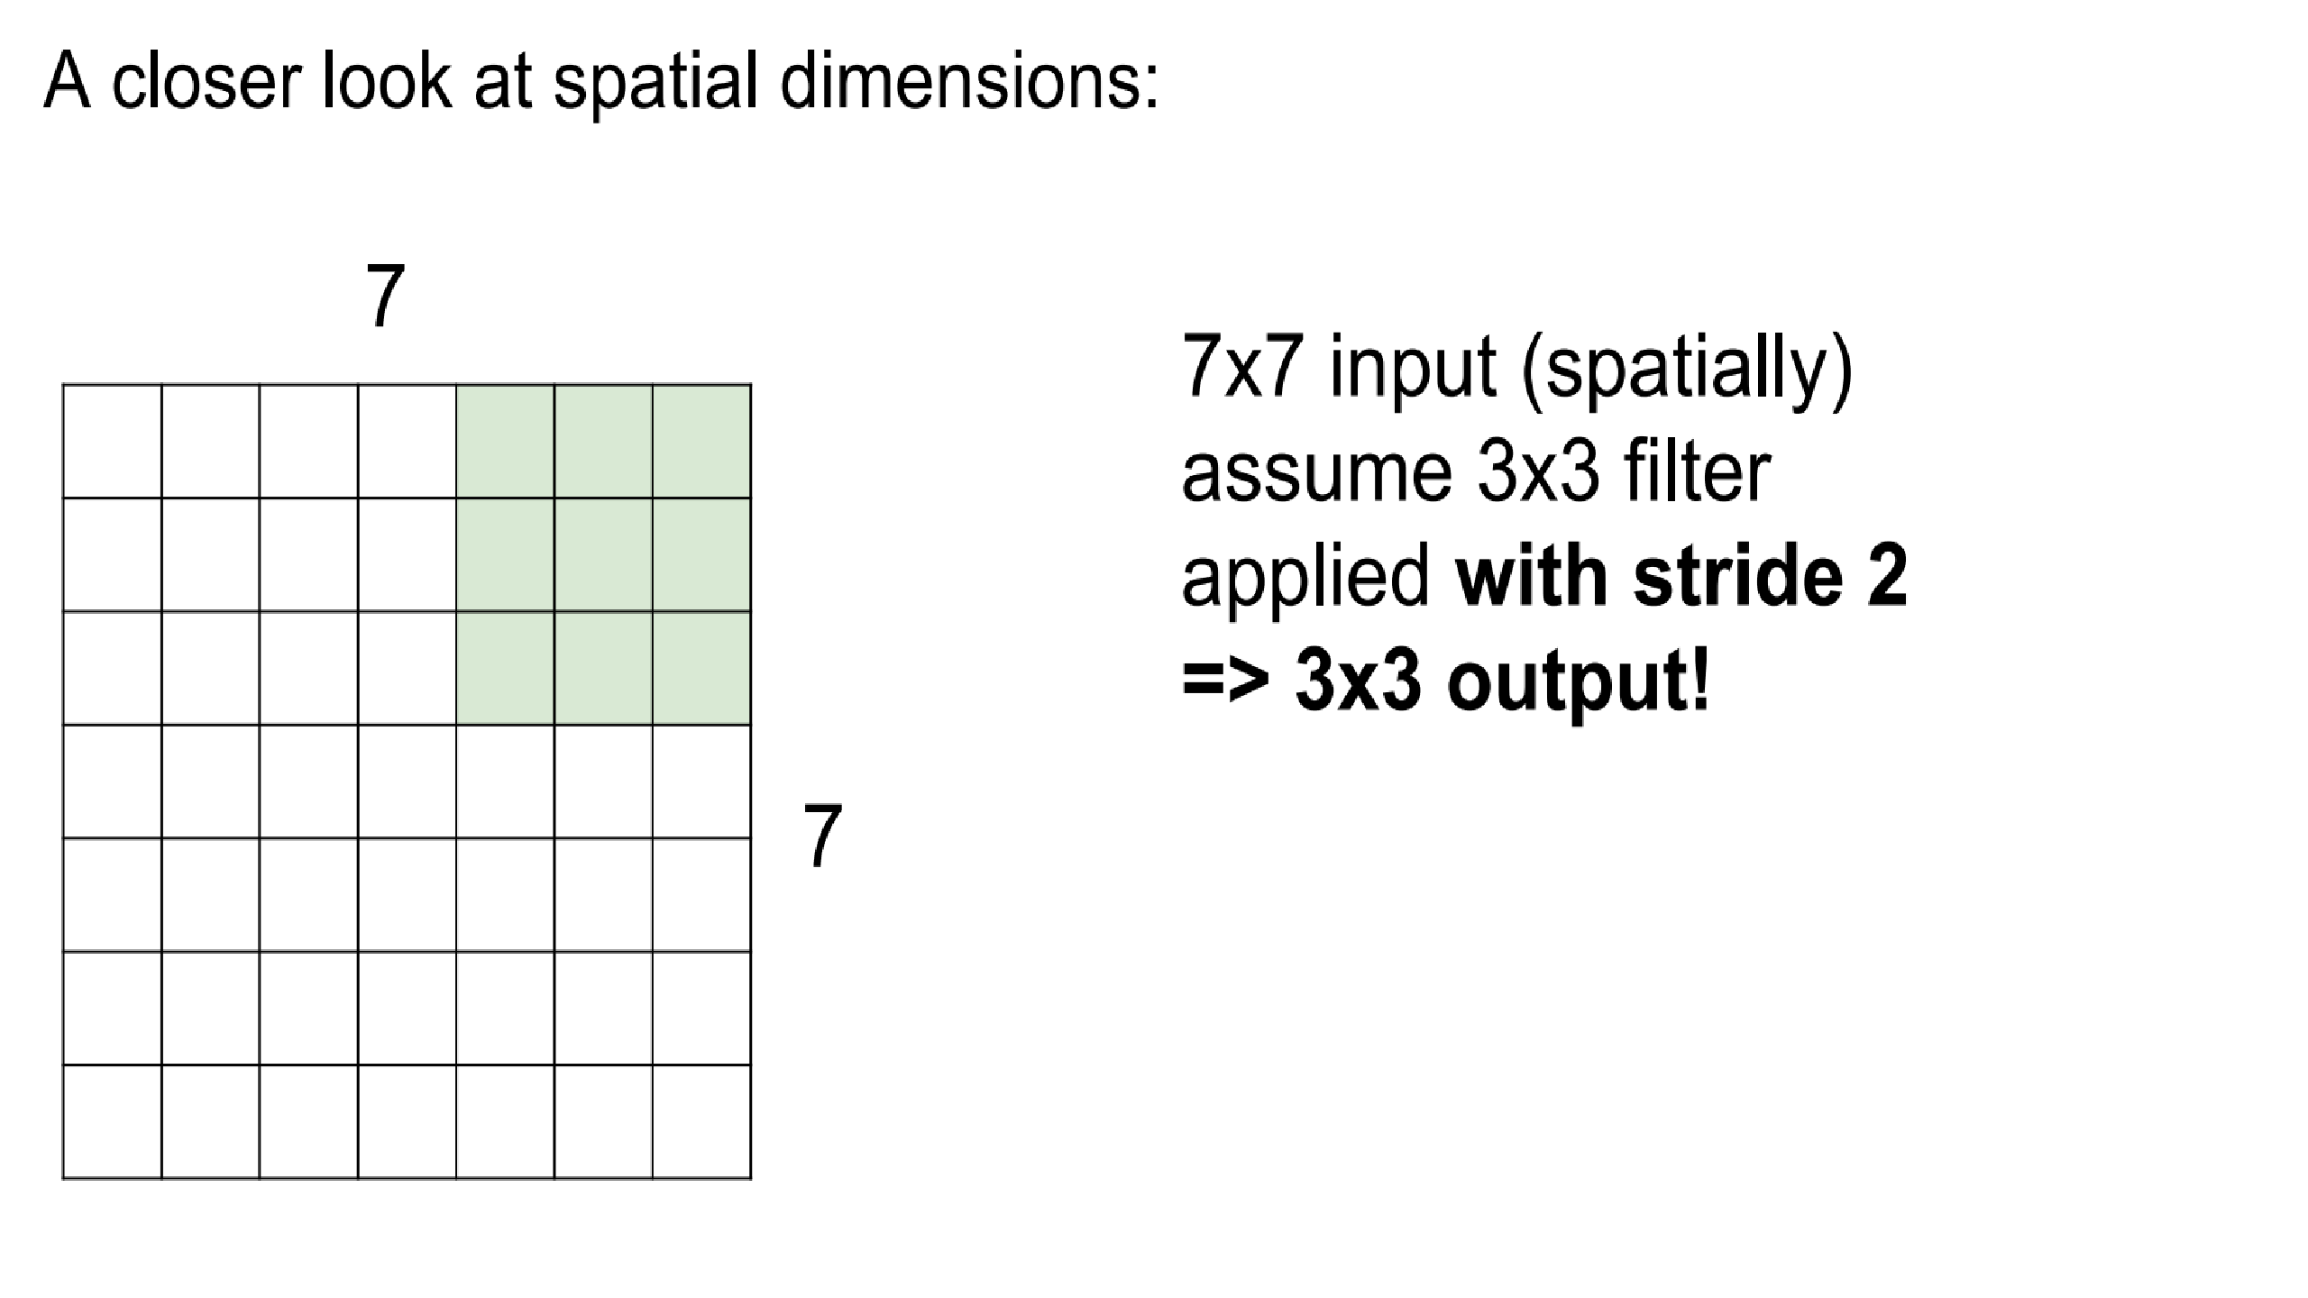
.

Slide 37
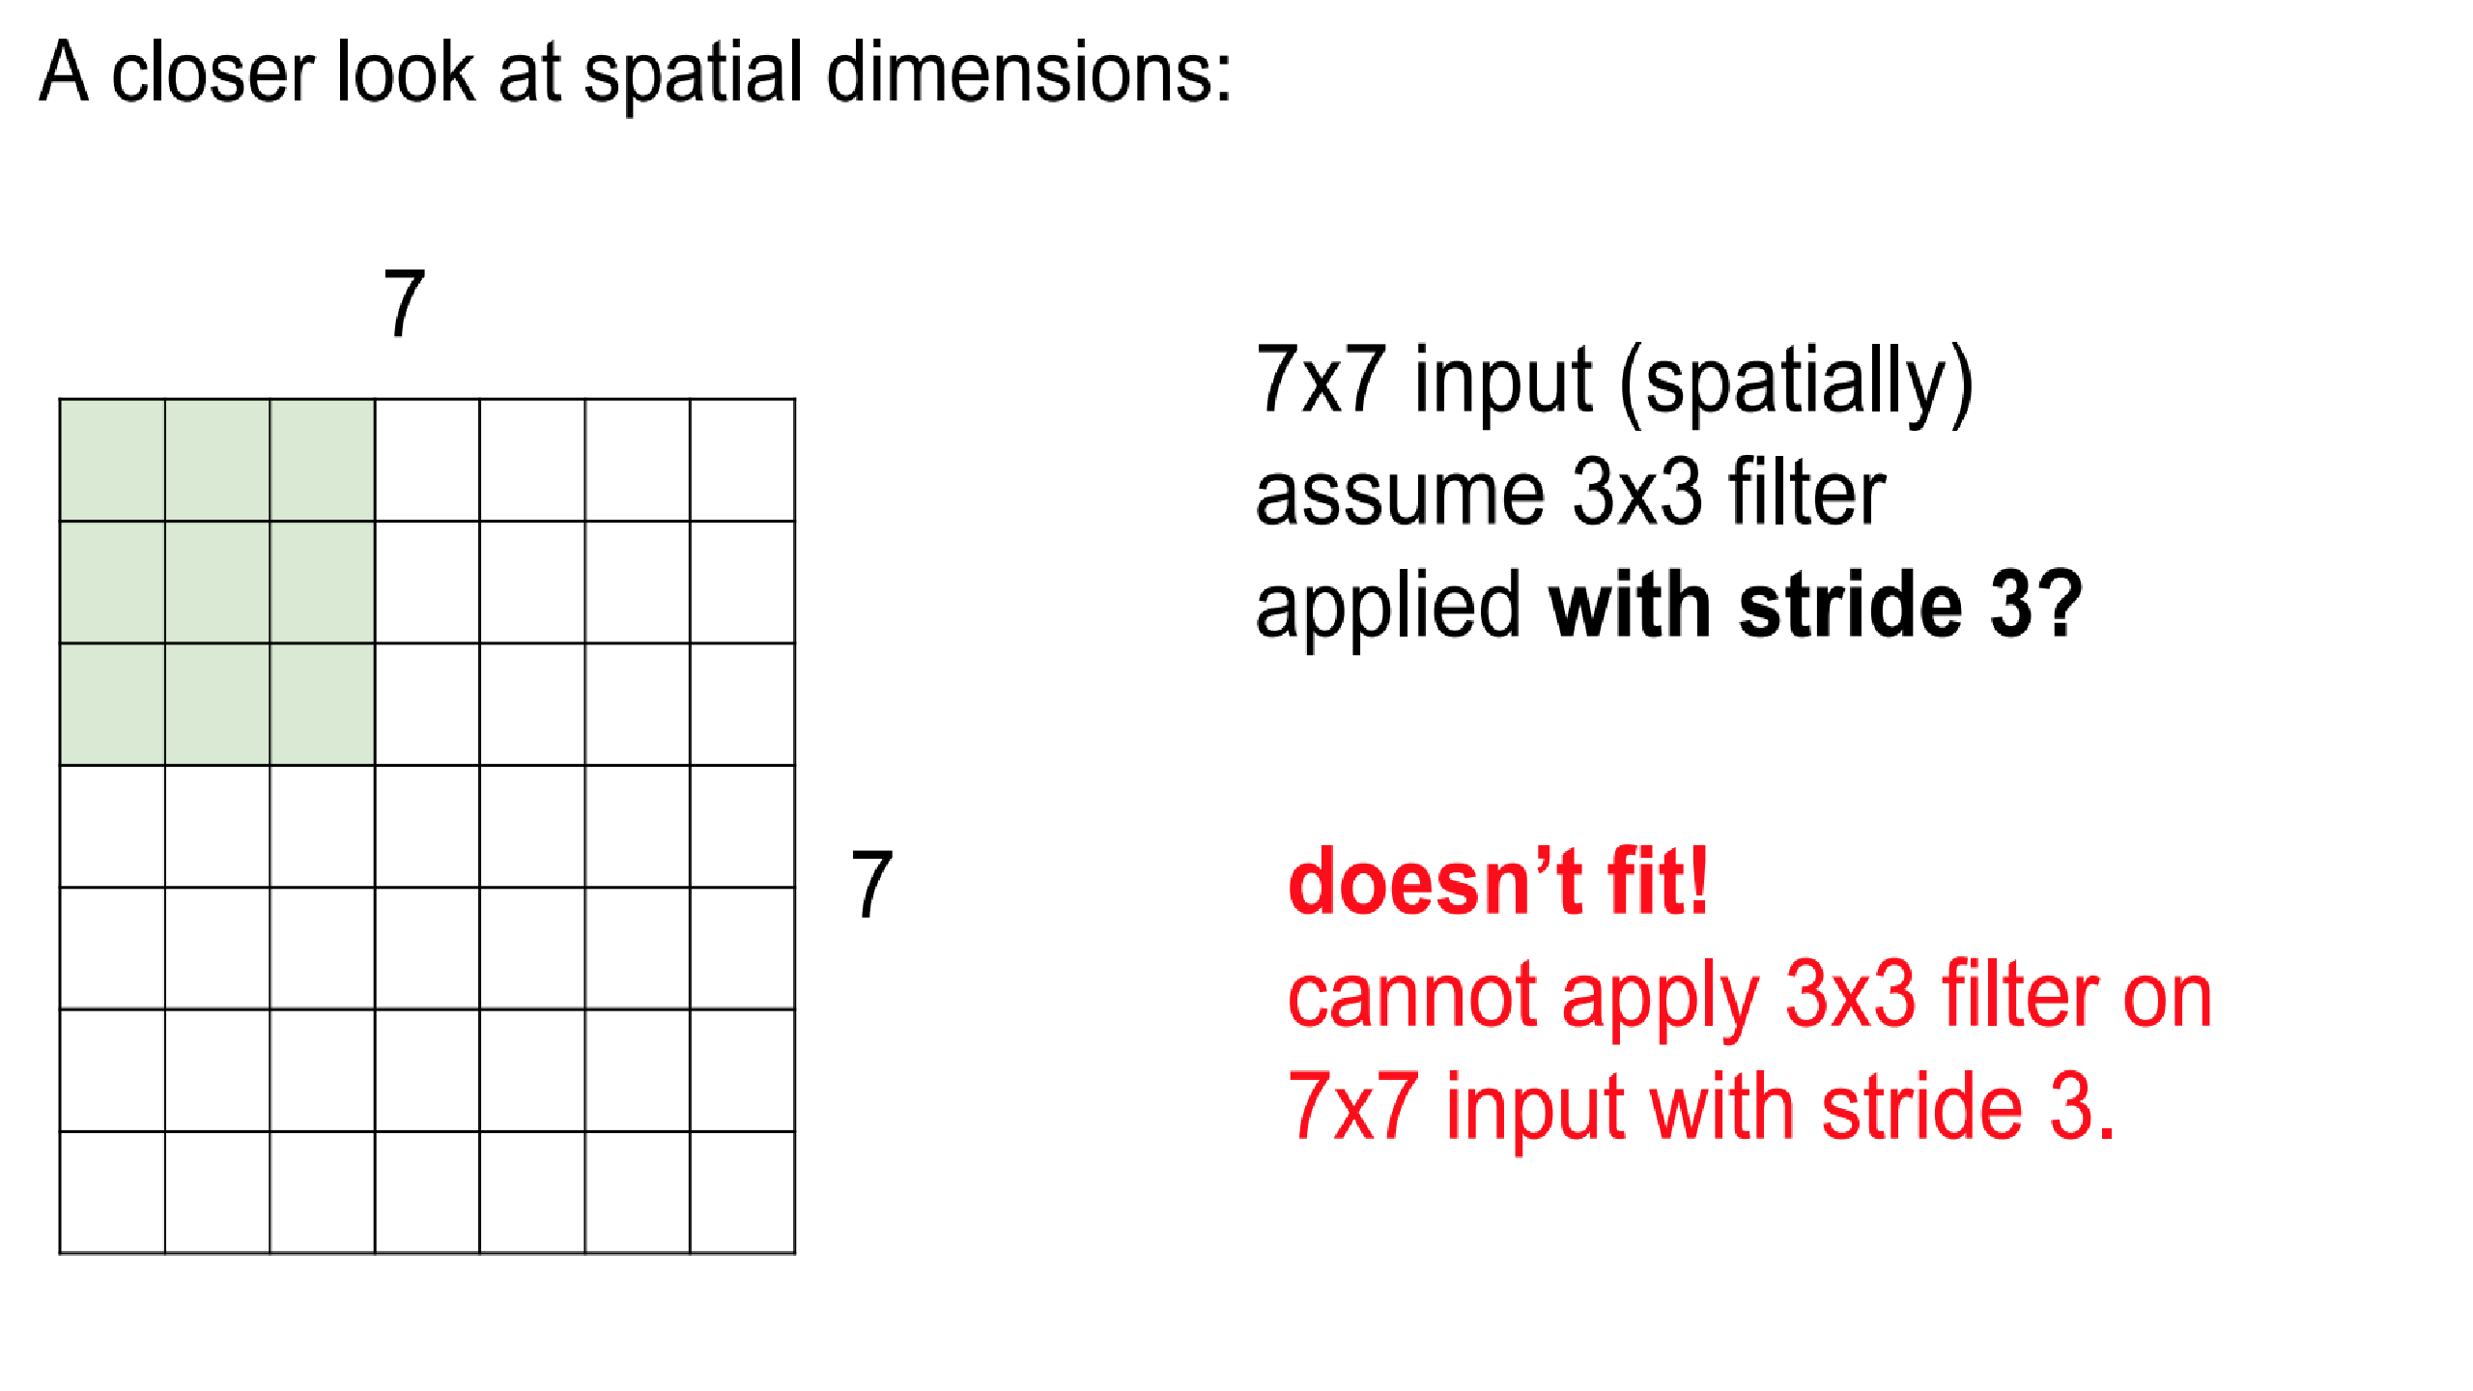
.

Slide 38
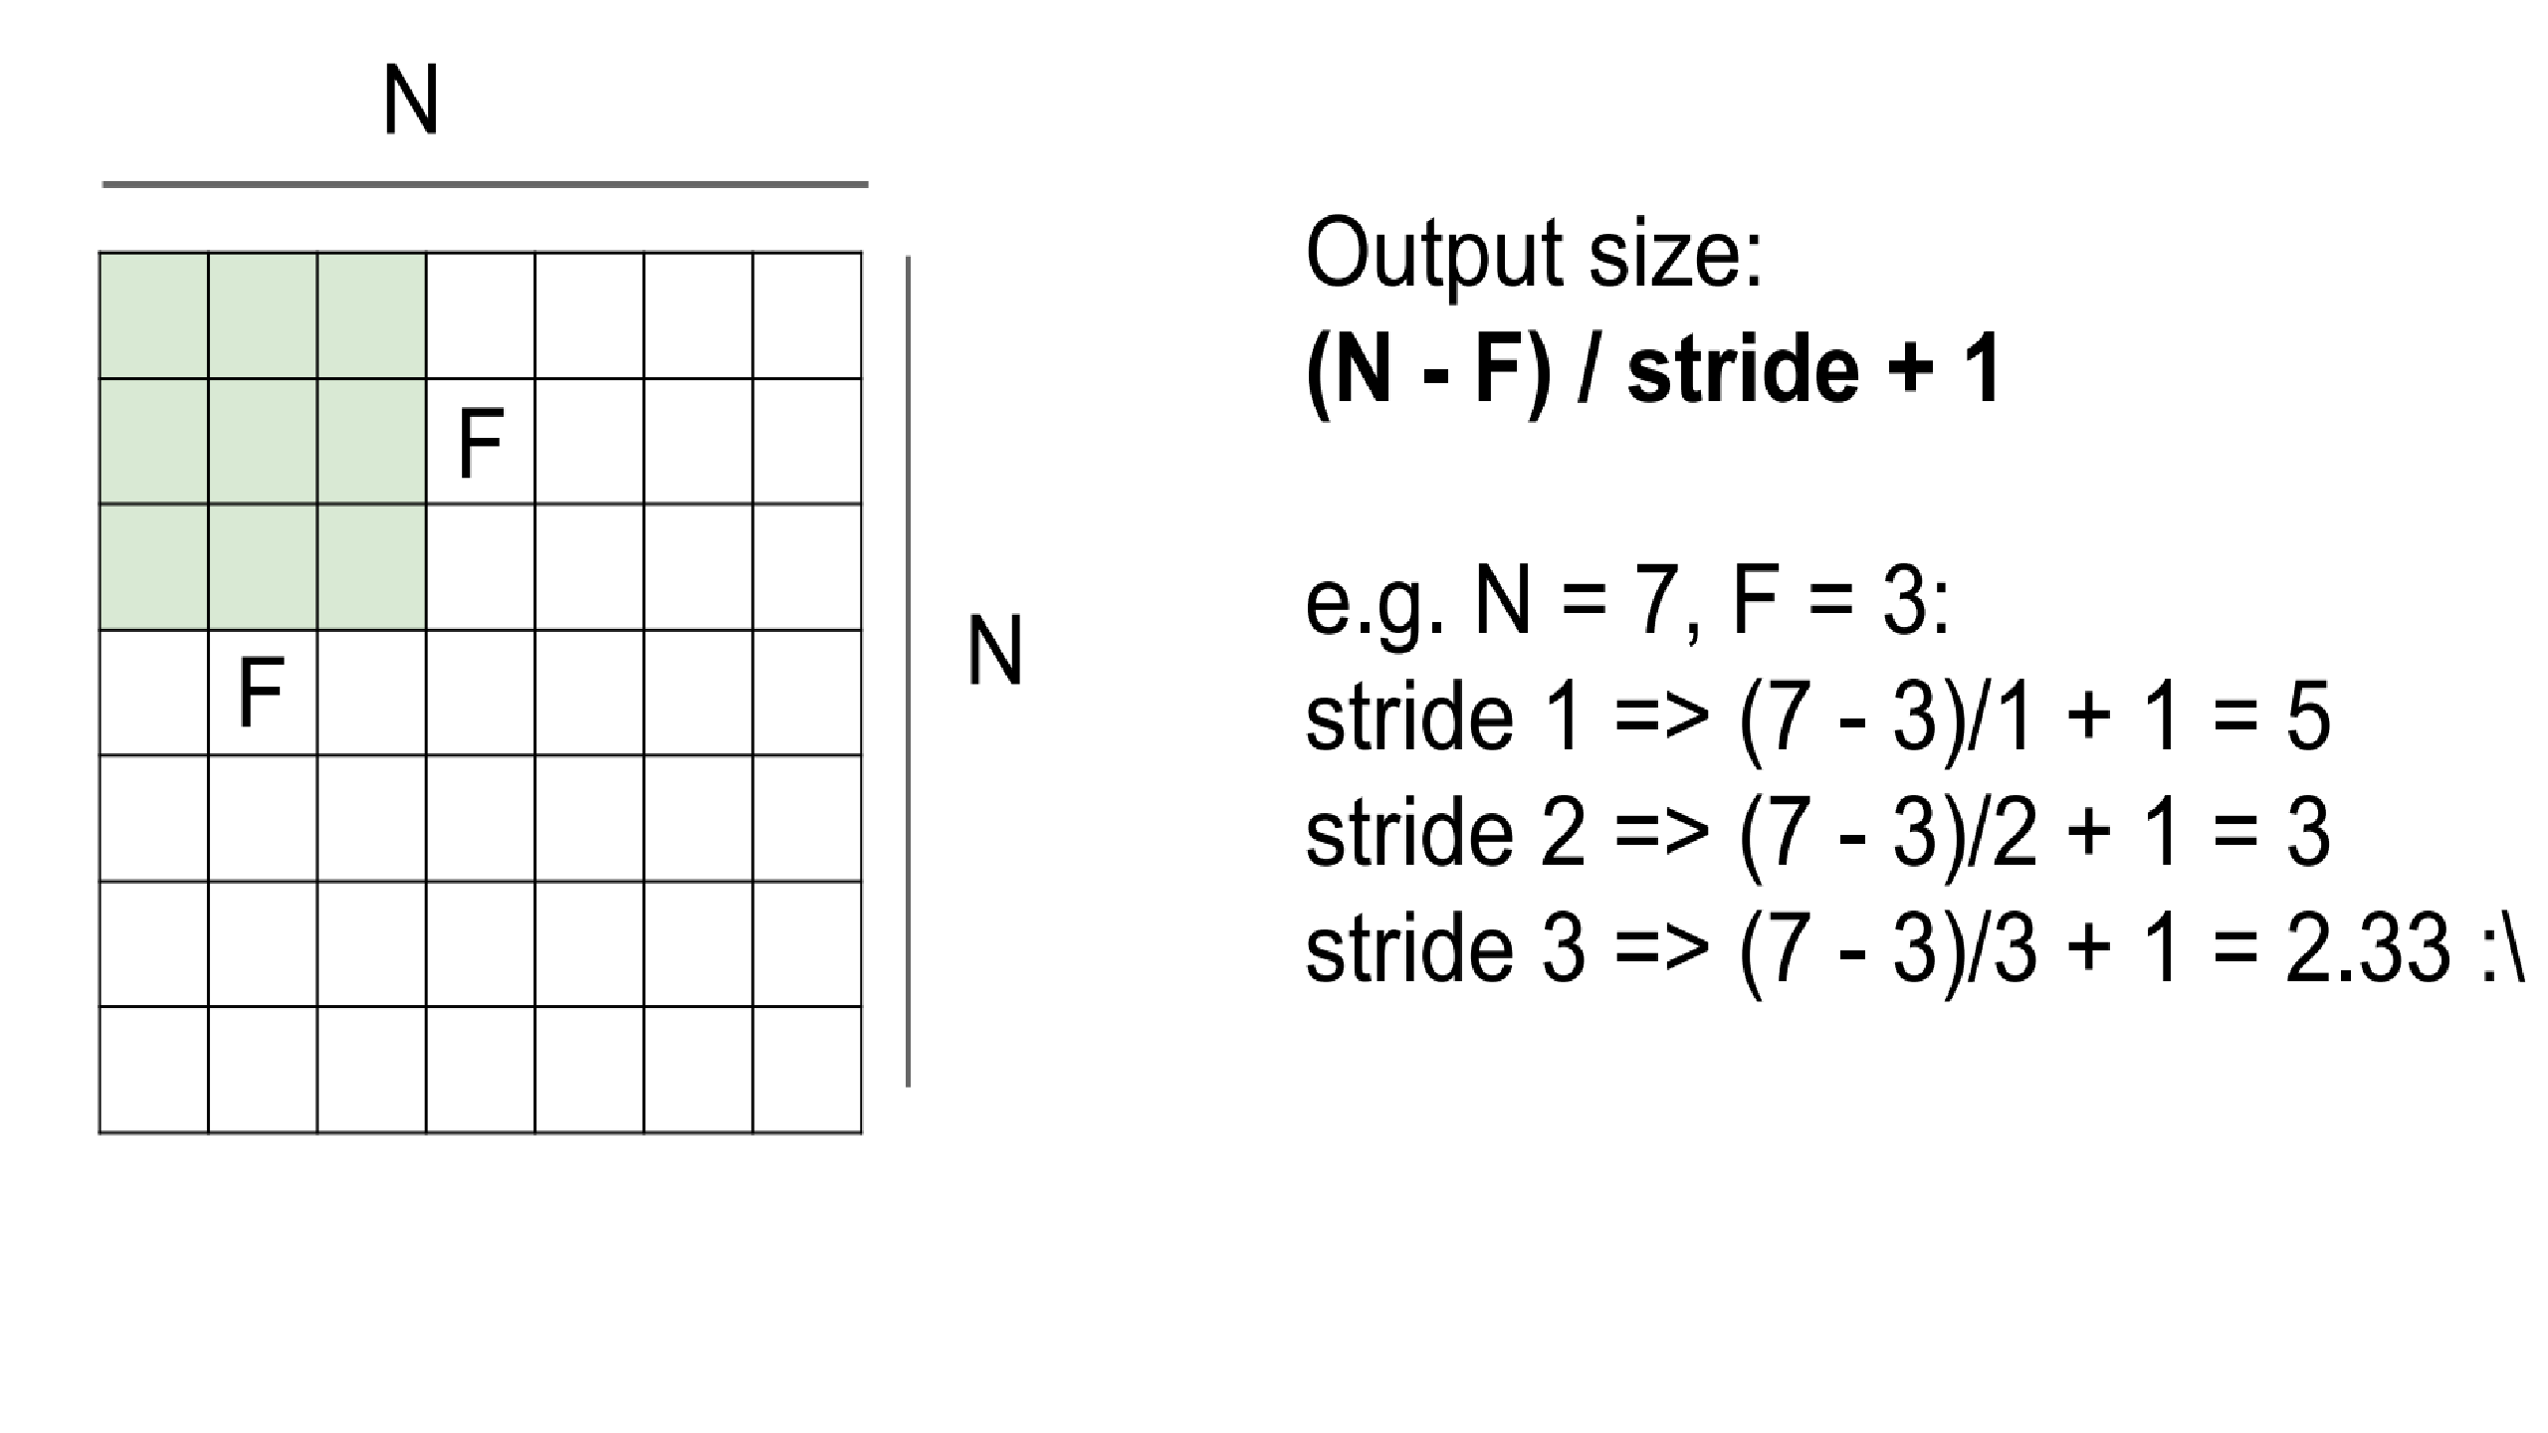
.

Slide 39
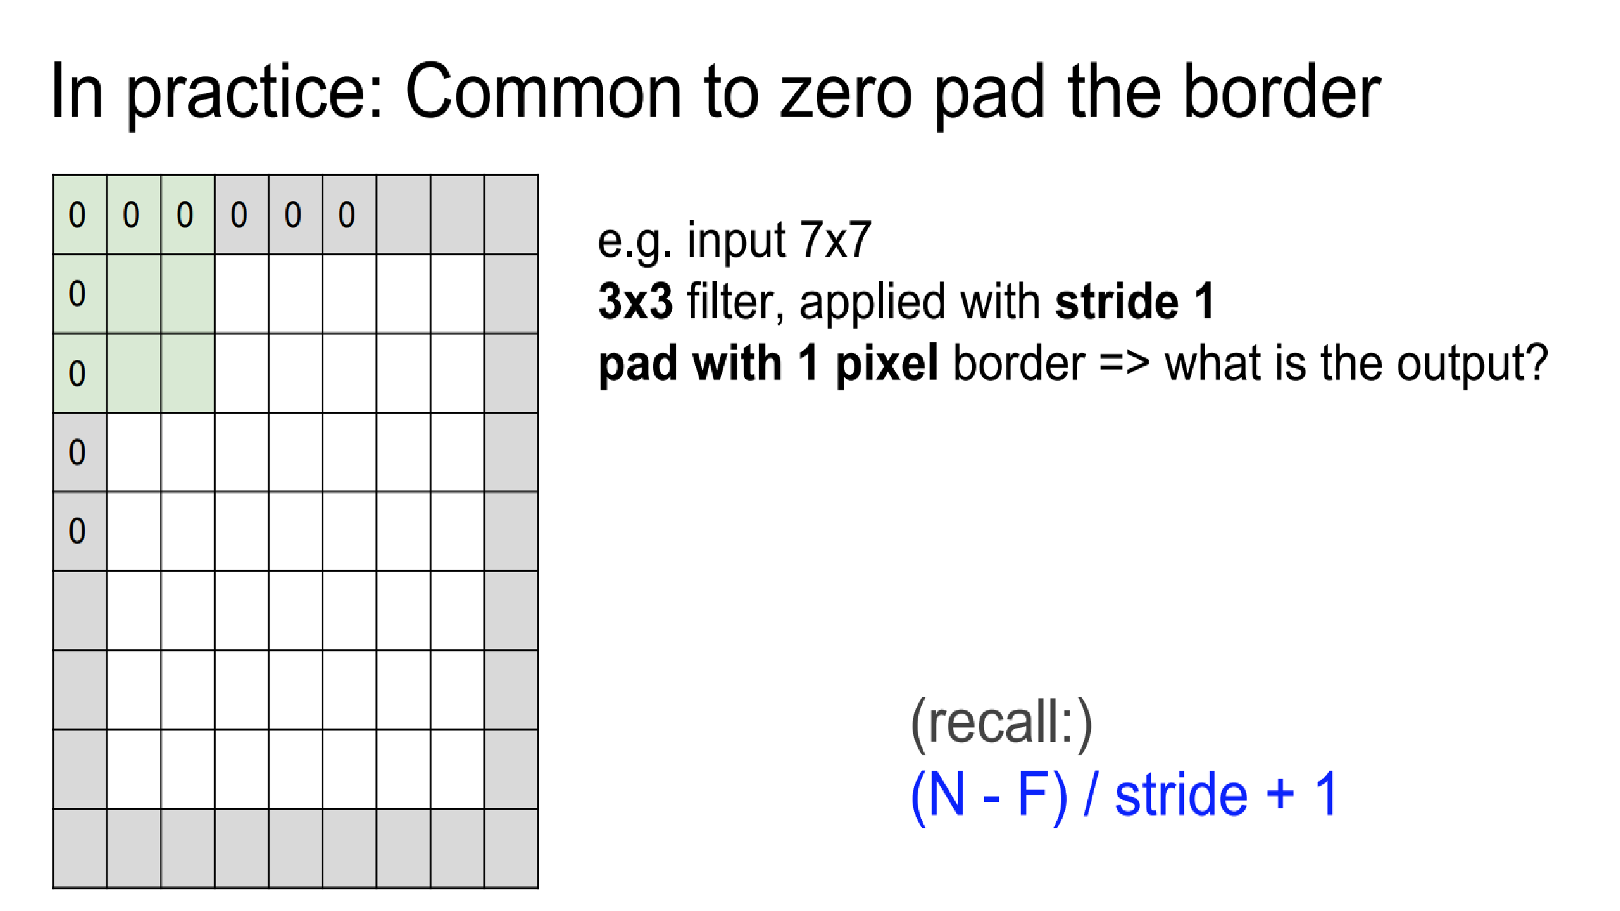
.

Slide 40
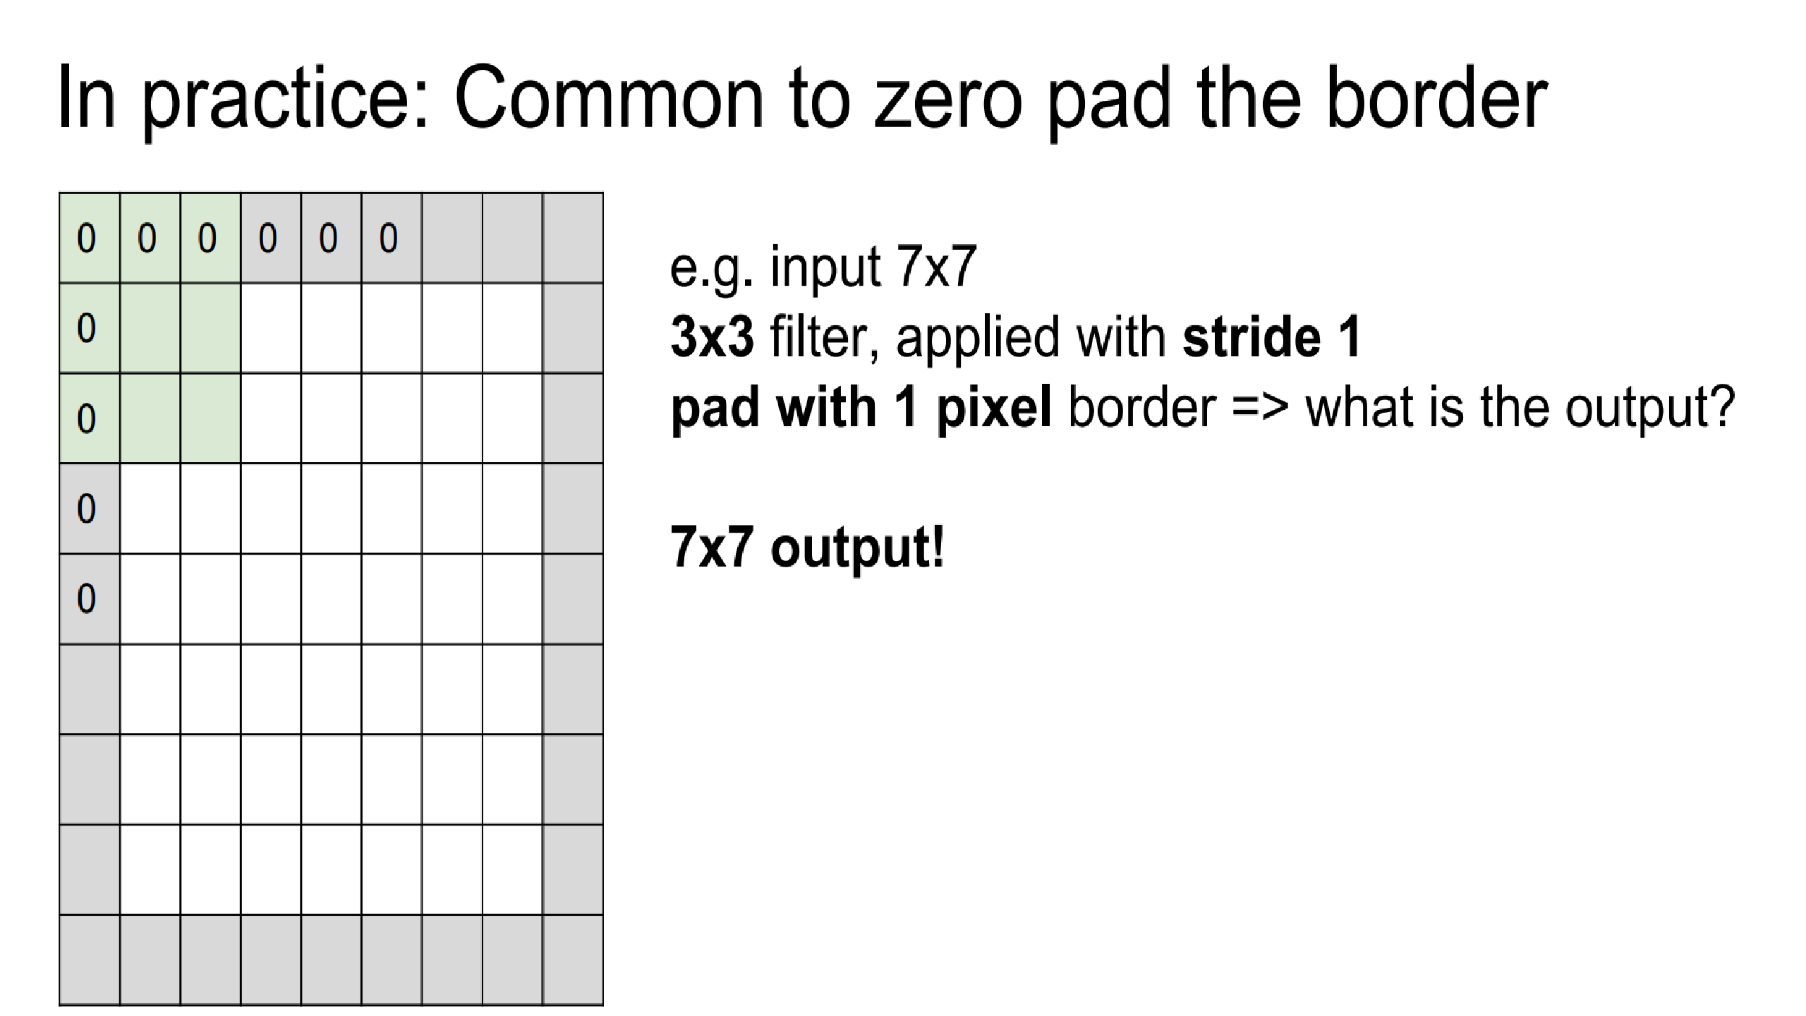

Slide 41
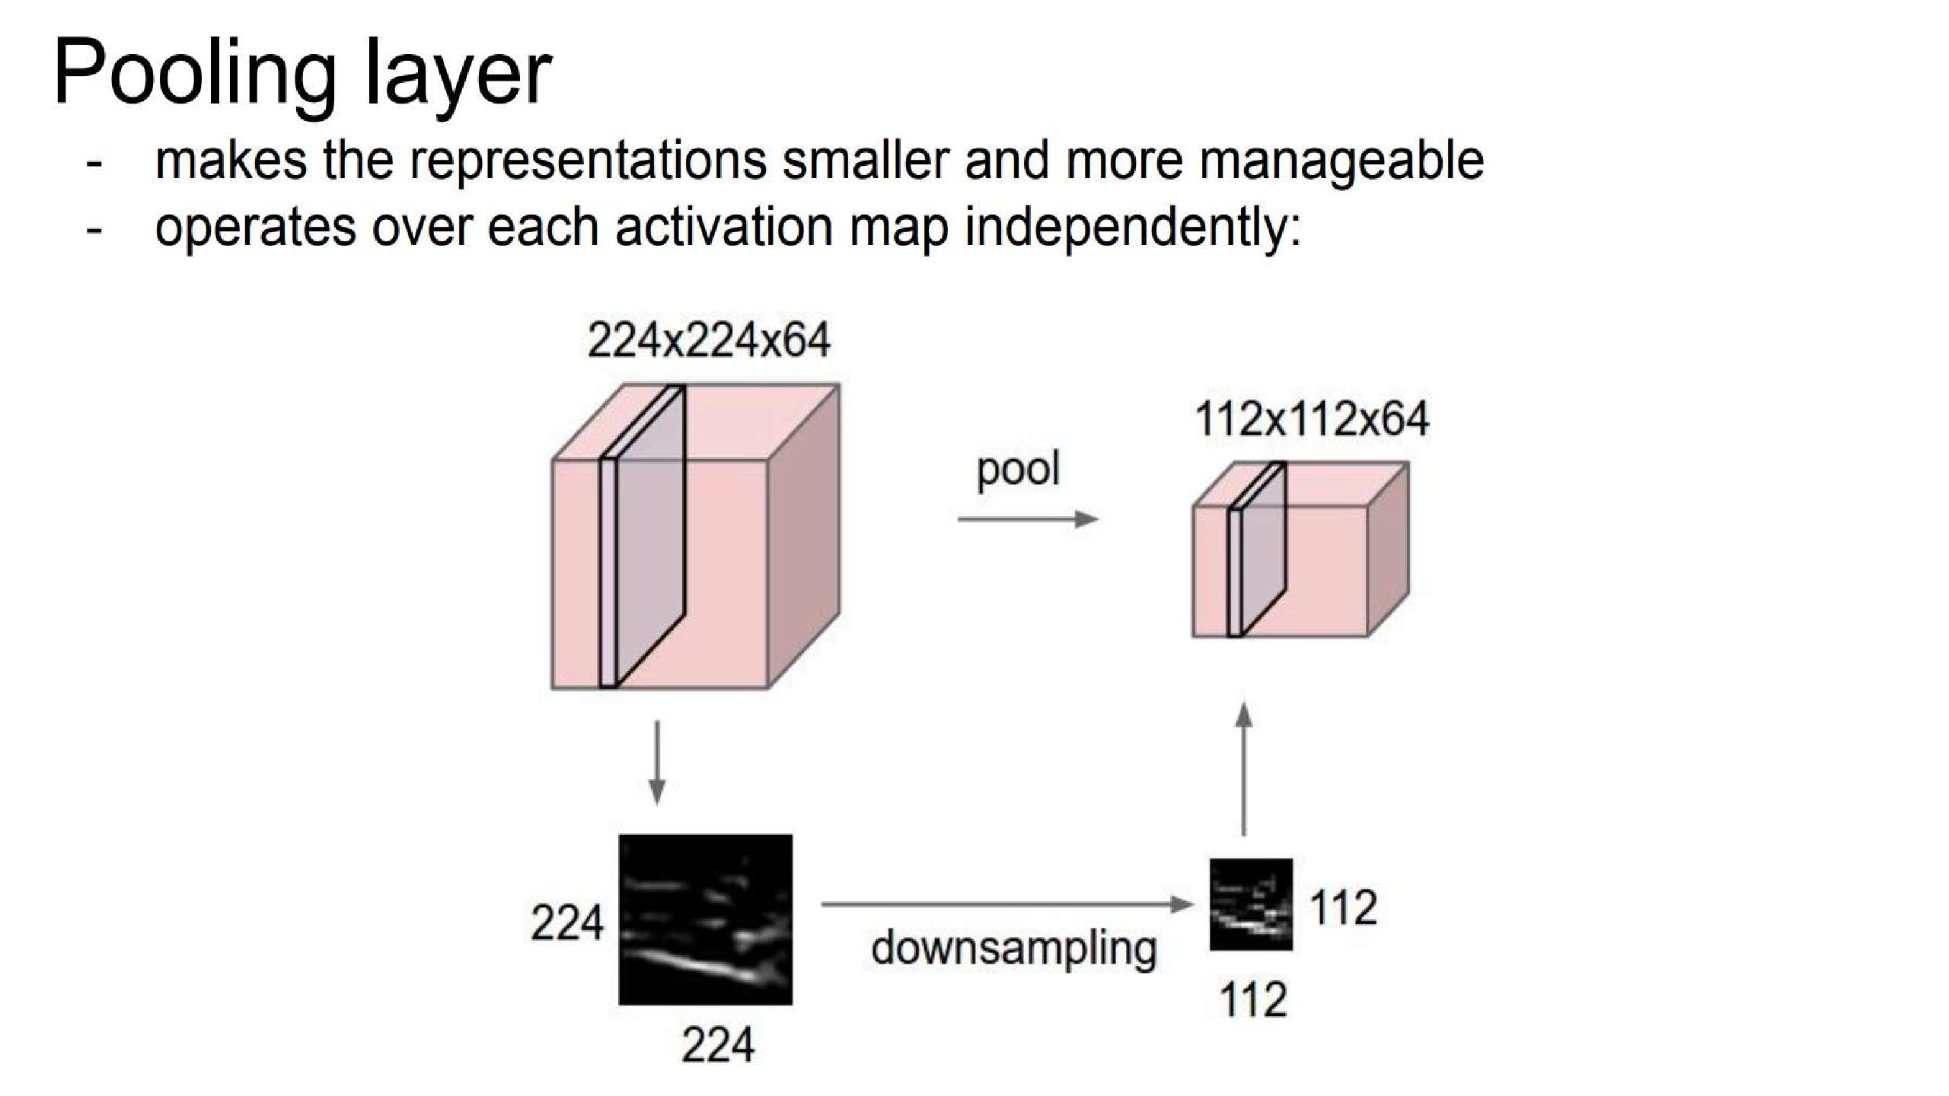
.

Slide 42
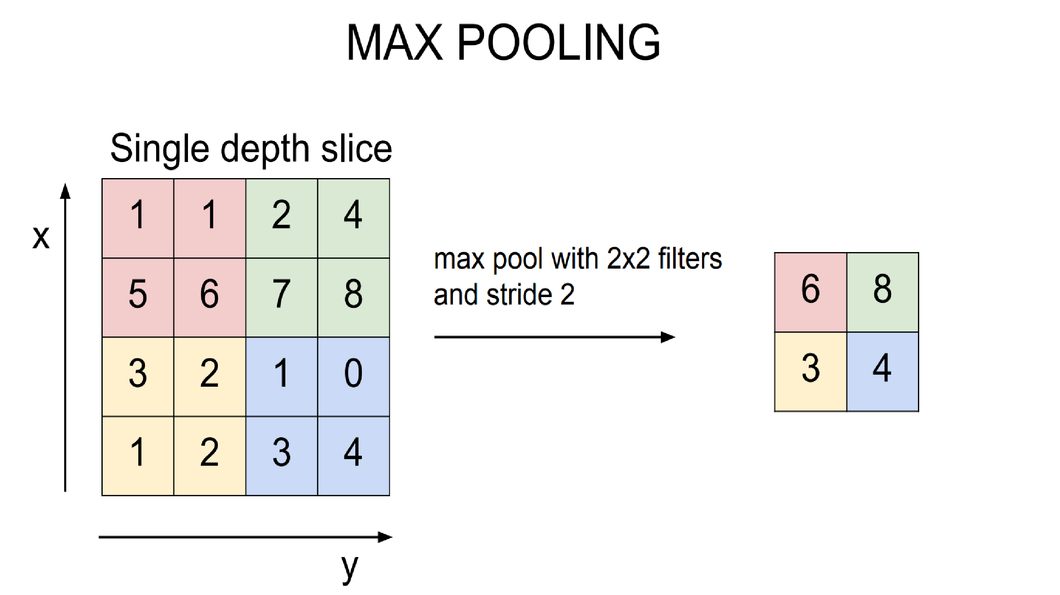

Slide 43
HYPER-PARAMETERS
Convolution
Filter Size
Number of Filters
Padding
Stride
Pooling
Filter Size
Stride
Fully Connected
Number of neurons

Slide 44
Recurrent Neural Network
Introduction to RNN
Architecture of RNN
Working of RNN
RNN Example
Drawback of RNN

Slide 45
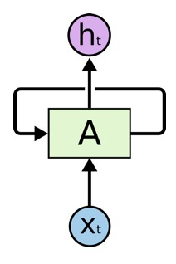
RNN
RNNs are a type of artificial neural network designed to recognize the patterns in sequences of data. It is used to
process the data sequentially.
Why can’t we accomplish this task with Feed forward network?
The drawback of feed forward network is that, it doesn't remember the inputs over the period of time.
To process the data sequentially we need a network that behave recurrently.

Slide 46
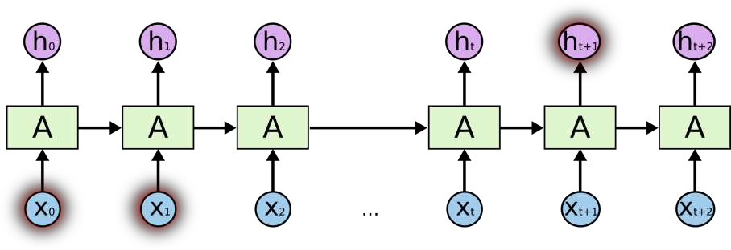
But there are also cases where we need to know more context of the input.
For example “I grew up in France…………………I speak fluent French” .
Unfortunately, as that gap grows, RNNs become unable to learn to connect the information.
This happens due to vanishing gradient and exploding gradient problem.

Slide 47
LSTM
LSTM
Architecture of LSTM
Working of LSTM
LSTM Example

Slide 48
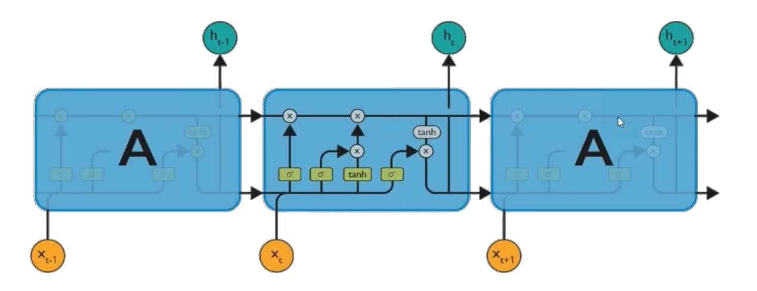
LONG SHORT-TERM MEMORY (LSTM)
Long Short Term Memory network – usually just called “LSTM” – are a special kind of RNN
They are capable of learning long-term dependencies.

Slide 49
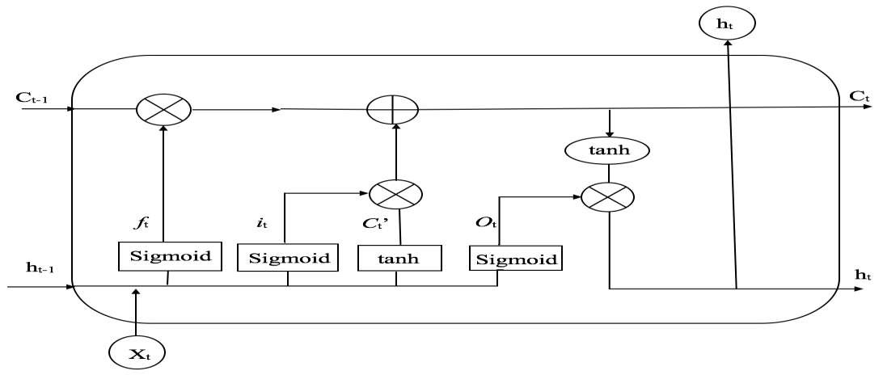
ARCHITECTURE OF LSTM
Why LSTM is different then RNN, because LSTM has cell state that deals with long term dependencies.

Slide 50
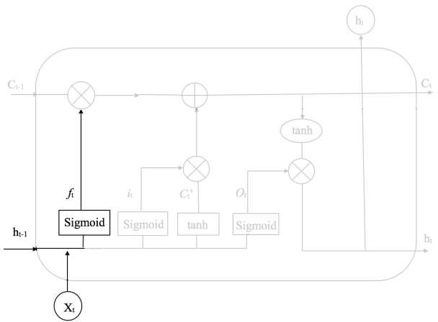
WORKING OF LSTM
Step 1: The first step in the LSTM is to identify those information that are not required and will be thrown away from the cell state. This decision is made of neural network with sigmoid activation function called forget gate layer.
𝑊_{𝑓} = weight
ℎ_{𝑡−1} = output from the previous time step
𝑋_{𝑡} = New input
𝑏_{𝑓} = bias

Slide 51
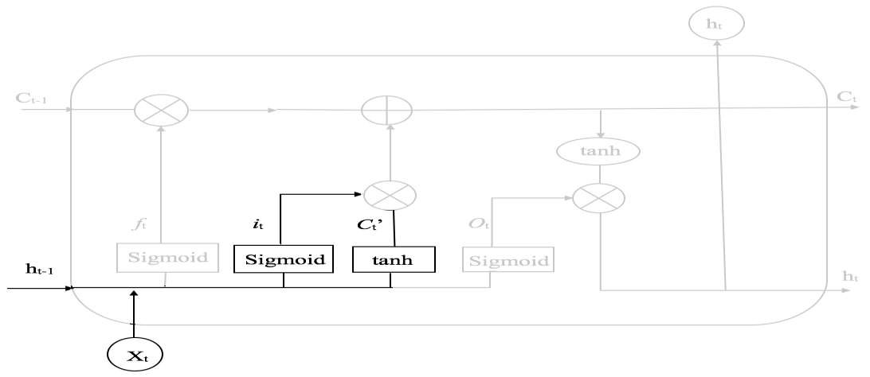
WORKING OF LSTM
Step 2: The next step is to decide, what new information we’re going to store in the cell state. This whole process
comprises of following steps. A NN layer with sigmoid
Sigmoid called the “input gate layer” decides which values will be updated.
Next, a NN layer with tanh activation creates a new vector that could be added to the state.
𝑖_{𝑡} = 𝑠𝑖𝑔𝑚𝑜𝑖𝑑(𝑊_{𝑖}
^{ℎ}𝑡−1^{, 𝑋}𝑡
+ 𝑏_{𝑖}
𝐶_{𝑡}′ = 𝑡𝑎𝑛ℎ(𝑊_{𝑐}
^{ℎ}𝑡−1^{, 𝑋}𝑡
+ 𝑏_{𝑐}
In the next step, we’ll combine these two to
update the state.

Slide 52
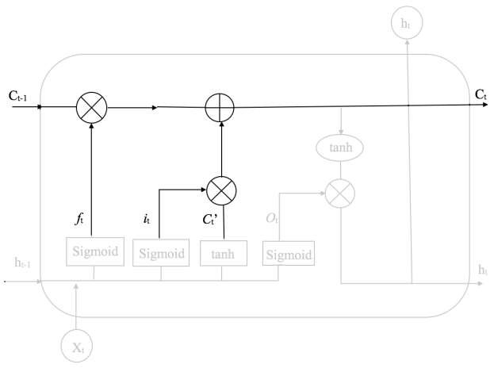
Step 3: Now, we will update the old cell states, C_{t-1} into the new cell state C_{t}. First, we multiply the old state (C_{t-1}) by f_{t},
forgetting the things we decided to forget earlier. Then, we add i * 𝐶 . This is the new vector values, scaled by how much we decided to update each cell state value.
𝐶_{𝑡} = 𝑓_{𝑡} ∗ 𝐶_{𝑡−1} + 𝑖_{𝑡} ∗ 𝐶_{𝑡}′

Slide 53
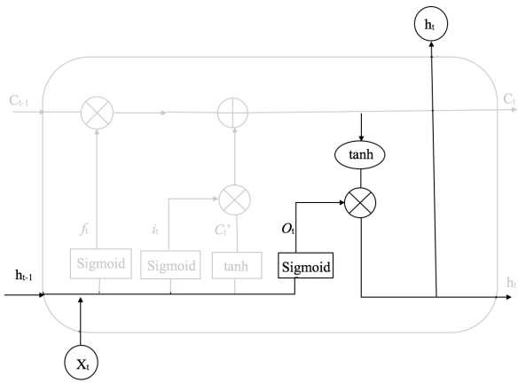
WORKING OF LSTM
Step 4: We will run a sigmoid layer which decides what parts of the cell state we’re going to output. Then, we put the cell state through tanh (push the values to be between -1 and 1) and multiply it by the output of the sigmoid gate, so that we only output the parts we decided to.
𝑂_{𝑡} = 𝑠𝑖𝑔𝑚𝑜𝑖𝑑(𝑊_{𝑜}
+ 𝑏_{𝑜} )
ℎ_{𝑡} = 𝑂_{𝑡} ∗ tan h( 𝐶_{𝑡} s

Slide 54
Activation Functions

Slide 55
Identity Function
f(x)=x
Derivative of f(x) f ‘(x)=1
Range(-∞ , ∞)
It is called Linear activation Function.

Slide 56
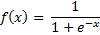
Sigmoidal Function:
Derivative of
Range(0 , 1)
It normalizes an input real value into range between 0 and 1

Slide 57
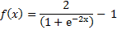
TanH Function:
f(x) = tanh(x) =
Derivative of Range(-1 , 1)
The tanh(x) function is a rescaled version of the sigmoid, and its output range is [−1 , 1] instead of [0 , 1].

Slide 58
How to avoid overfitting in Neural Networks???

Slide 59
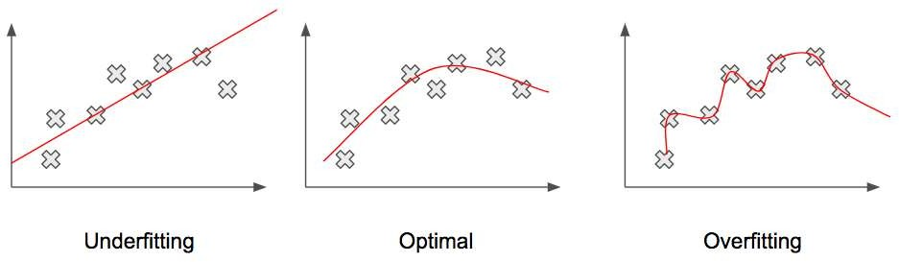
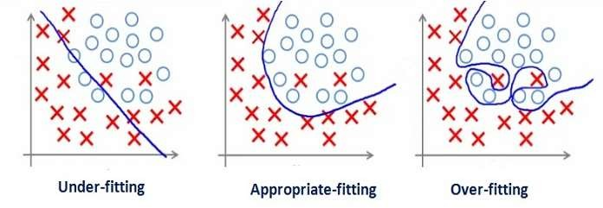

Slide 60
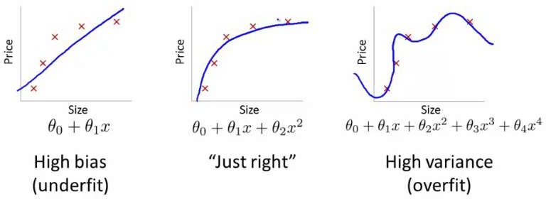

Slide 61
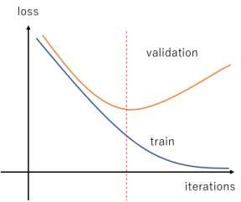
How to find overfitting or underfitting
?

Slide 62
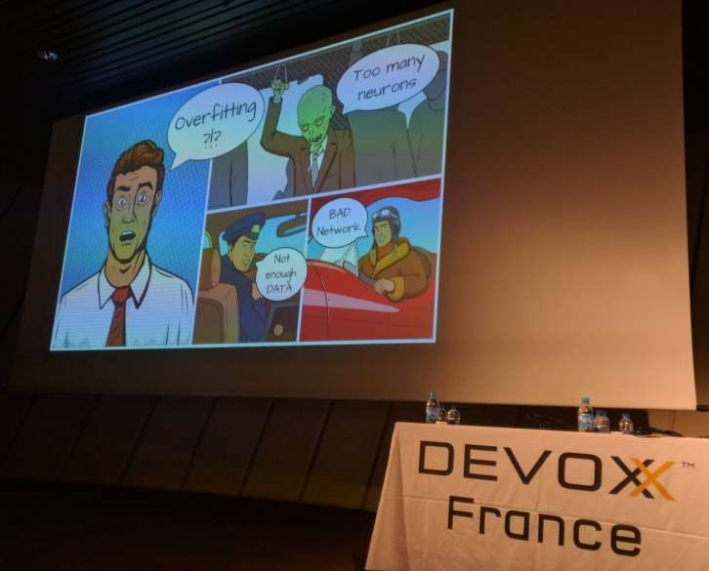
Solutions for overfitting?
Increase training examples
Early Stopping
Regularization
L2
L1
Dropout

Slide 63


Slide 64

Early stopping
Watch validation curve while training and stop updating weight once your validation error starts increasing

Slide 65


Slide 66
Example in Keras
from keras import regularizers
model.add(Dense(64, input_dim=64, kernel_regularizer=regularizers.l2(0.01), activity_regularizer=regularizers.l1(0.01)))

Slide 67

Dropout

Slide 68
Use case: LSTM and Convolutional Neural Network For Sequence Classification
Convolutional neural networks excel at learning the spatial structure in input data
The IMDB review data does have a one-dimensional spatial structure in the sequence of words in reviews and the CNN may be able to pick out invariant features for good and bad sentiment
This learned spatial features may then be learned as sequences by an LSTM layer.

Slide 69
Reading the data
(X_train, y_train), (X_test, y_test) = imdb.load_data(num_words=top_words) # truncate and pad input sequences max_review_length = 500 X_train = sequence.pad_sequences(X_train, maxlen=max_review_length) X_test = sequence.pad_sequences(X_test, maxlen=max_review_length)

Slide 70
Creating model using CNN and LSTM
embedding_vecor_length = 32 model = Sequential() model.add(Embedding(top_words, embedding_vecor_length, input_length=max_review_length)) model.add(Conv1D(filters=32, kernel_size=3, padding='same', activation='relu')) model.add(MaxPooling1D(pool_size=2)) model.add(LSTM(100)) model.add(Dense(1, activation='sigmoid')) model.compile(loss='binary_crossentropy', optimizer='adam', metrics=['accuracy']) print(model.summary()) model.fit(X_train, y_train, epochs=3, batch_size=64)

Slide 71
Reading image files
train_path = './PetImages’
train_batches = ImageDataGenerator().flow_from_directory (train_path,target_size=(224,224),classes=['dog','cat'],batch_size=10)

Slide 72
Reading the text
df1 = pd.read_csv('./imdb_master.csv',encoding='latin-1’)
df1['label'] = df1['label'].map({'neg':0,'pos':1})
max_features = 6000 tokenizer = Tokenizer(num_words=max_features) tokenizer.fit_on_texts(df1['review']) list_tokenized_train = tokenizer.texts_to_sequences(df1['review']) max_len = 130 X_train = pad_sequences(list_tokenized_train,maxlen=max_len) y_train = df1['label']

Slide 73
How to save and then load keras model parameters
model.save('model.h5’)
*** later
model = load_model('model.h5’)
print(model.evaluate(X_train,y_train))

Slide 74
References
https://www.youtube.com/watch?v=yX8KuPZCAMo
https://www.linkedin.com/pulse/list-useful-links-videos-slides-articles-deep-farshid-pirahansiah?articleId=6274891035365732352#comments-6274891035365732352&trk=prof-post

Slide 75
Books
TensorFlow for Machine Intelligence (TFFMI)
Hands-On Machine Learning with Scikit-Learn and TensorFlow. Chapter 9: Up and running with TensorFlow
Fundamentals of Deep Learning. Chapter 3: Implementing Neural Networks in TensorFlow (FODL)
Deep Learning with Keras: Implementing deep learning models and neural
20

